Slide 1
BUILDING WITH NO-CODE
COURSE 04
What can AI do today
that it could not do
two years ago?
From chatbots to systems that create, decide, act and transact.
FROM AI KNOWLEDGE TO AI IN PRACTICE

Slide 2
START HERE
AI has changed again.
01
02
03
CHAT
MULTIMODAL
REASON
Ask and answer
See and hear
Work through
04
05
06
AGENTS
WORKFLOWS
TRANSACT
Use tools
Finish tasks
Pay for services
Which of these would have felt impossible in 2023?
Framing timeline: examples mark waves of capability becoming usable, not invention dates.
02

Slide 3
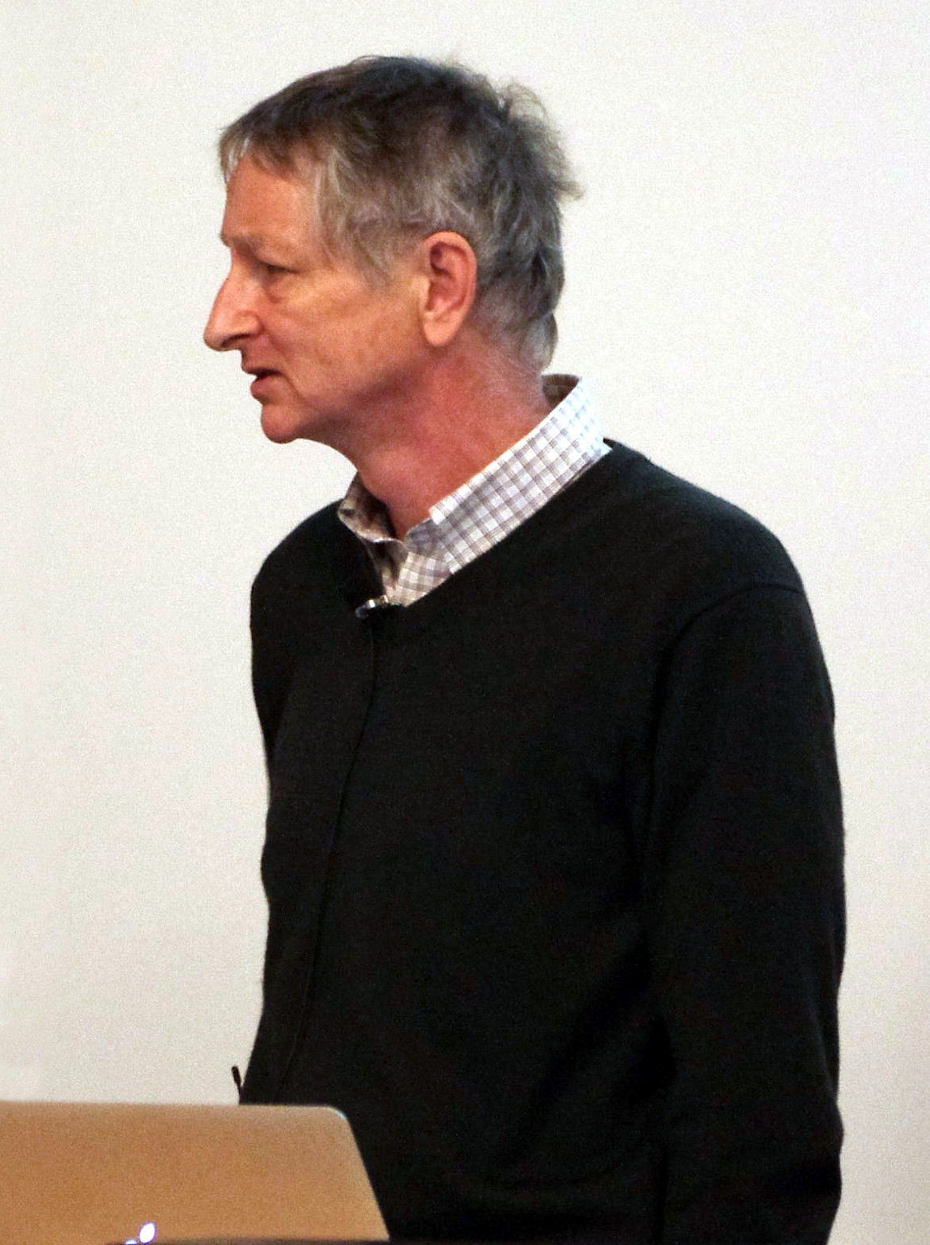
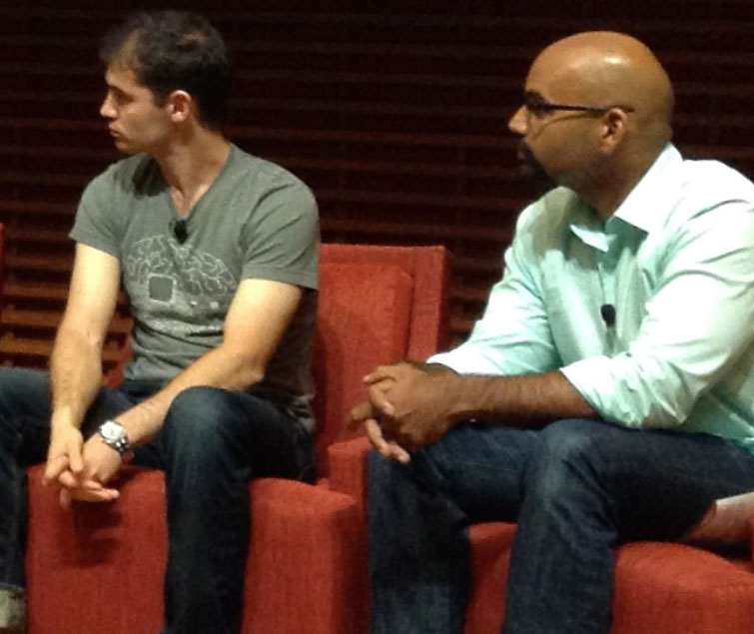
A SHORT HISTORY · THE IDEAS ARE OLDER
The shift came when ideas met data and compute.
1943
The neuron as a mathematical model.
2012
AlexNet scaled deep learning on GPUs.
The research did not begin with OpenAI.
Geoffrey Hinton · 2013
Ilya Sutskever (left) · 2014
History: McCulloch & Pitts (1943); AlexNet (2012). Photos: E. Bach and S. Jurvetson, Wikimedia Commons.
03

Slide 4
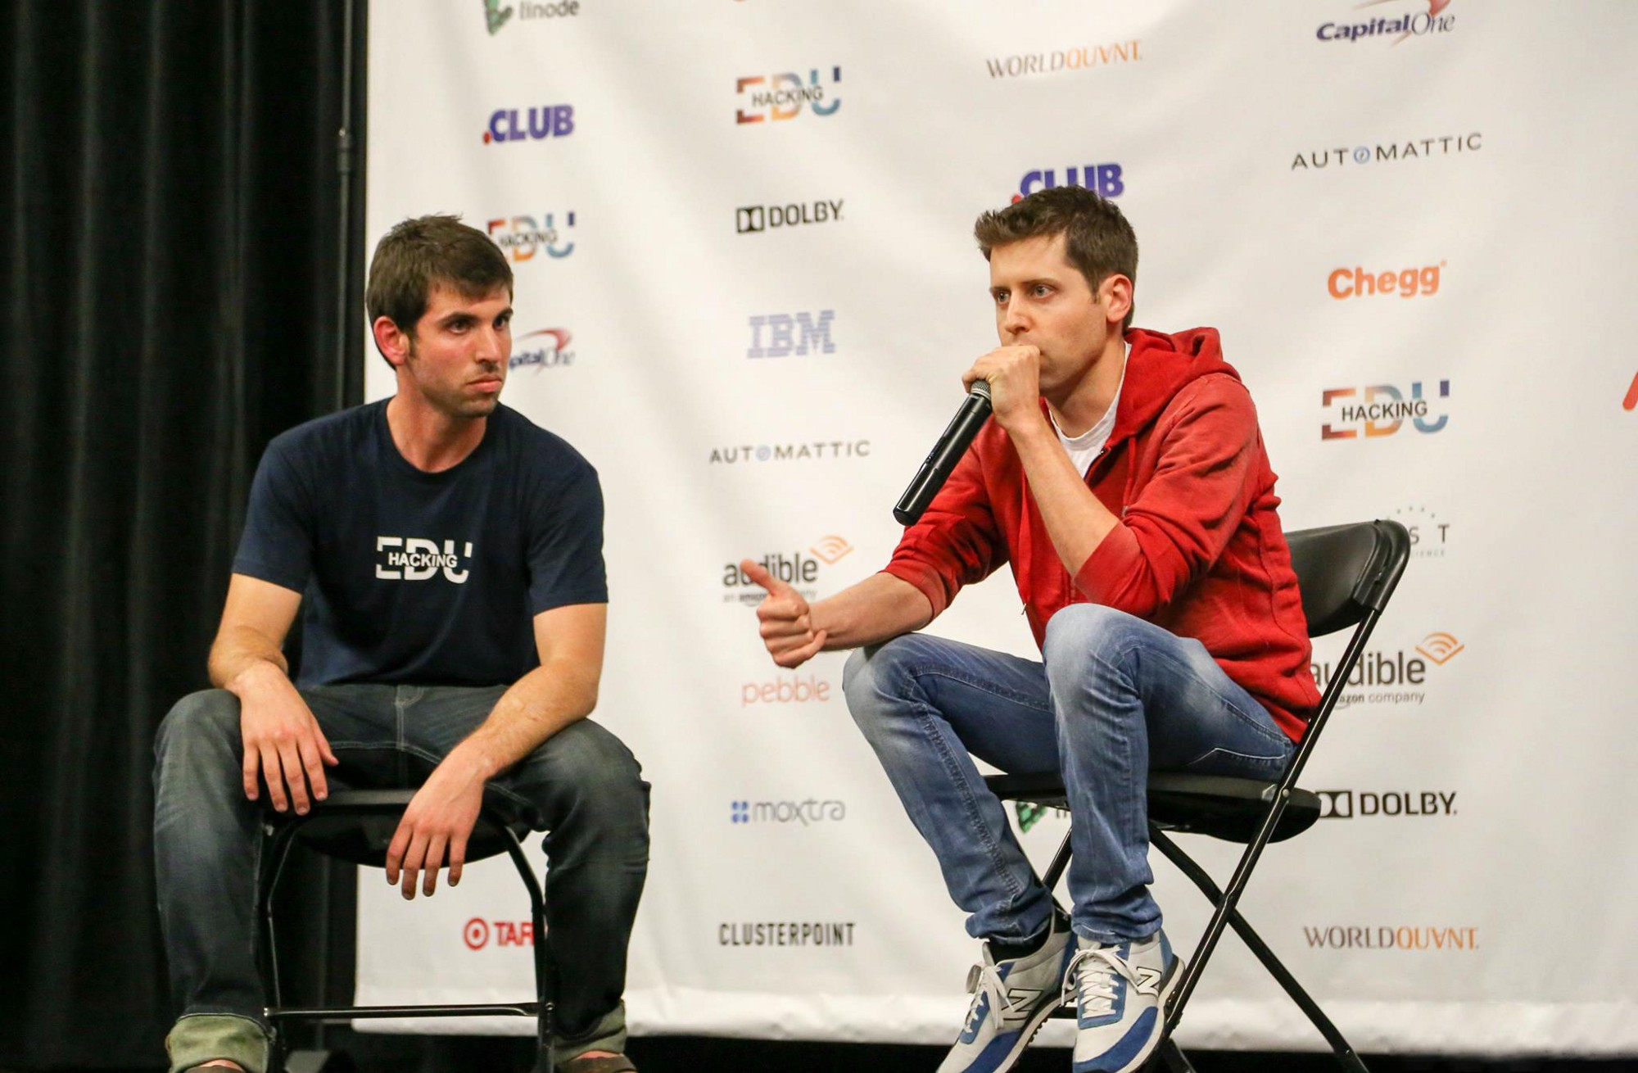
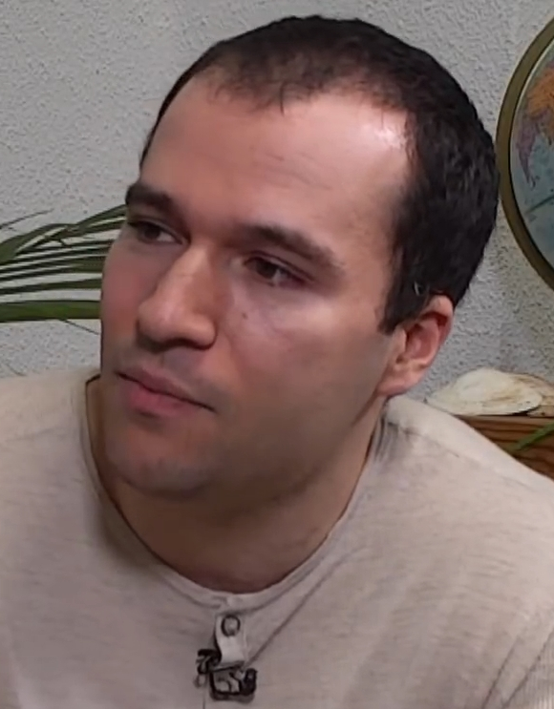
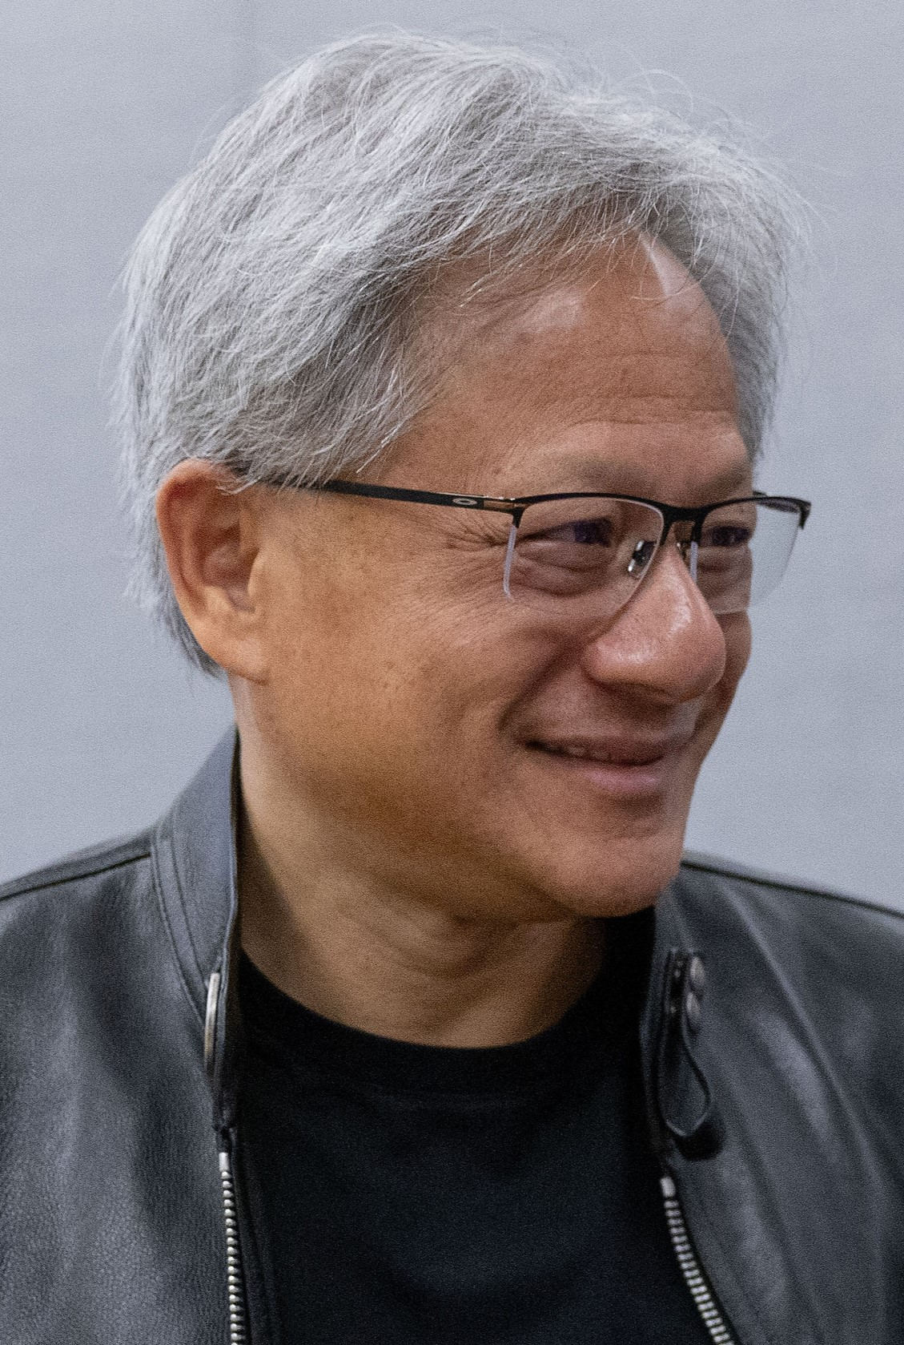
2015-2016 · A LAB AND A MACHINE
OpenAI meets accelerated computing.
Sam Altman
Greg Brockman
OpenAI was introduced in 2015.
In 2016, Huang delivered an NVIDIA DGX-1 to the lab.
Jensen Huang
OpenAI (2015); NVIDIA (2016). Photos: Alexlcory, Simulation, P. Dasilva / EC; details in notes.
04

Slide 5
A NEW FRONT DOOR · 2017—2022
The ideas were older. The doorway was new.
2017
2018
2022
TRANSFORMER PAPER
GPT
CHATGPT
Attention Is All You Need.
Pretrained language models.
AI you could simply talk to.
A research breakthrough became a public tool.
SAME FIELD. A MUCH EASIER WAY IN.
Vaswani et al., Attention Is All You Need (2017); OpenAI GPT (2018); ChatGPT launch (2022).
05

Slide 6
01 / 05
THE MECHANICS
How does a model learn and reply?
Examples become weights. A prompt becomes an output.
COURSE 4 · 0205EE

Slide 7

HOW LANGUAGE MODELS LEARN
Training is repeated prediction and correction.
01
EXAMPLE
Show a passage of text.
02
PREDICTION
Guess a hidden or next piece.
03
ERROR
Compare with the actual piece.
04
UPDATE
Adjust weights; repeat.
Training changes the weights. Inference uses them.
Google ML Crash Course, neural-network training and LLMs; Cursor Learn, How AI Models Work. Illustrative AI-generated photo.
07

Slide 8

NOW ASK THE TRAINED MODEL
It generates the reply one piece at a time.
PROMPT
Write a luxury line for a potato.
MODEL
Predicts the next token
then repeats with that token added.
The everyday, reimagined.
Tokens are text pieces; their boundaries depend on the tokenizer.
Google ML Crash Course, Introduction to LLMs; Cursor Learn, How AI Models Work. Token boundaries below are illustrative. AI-generated photo.
08

Slide 9

SAME BRIEF · DIFFERENT OUTPUTS
The model can take more than one plausible path.
A / DRAMATIC
The everyday,
reimagined.
B / PLAYFUL
Everyday gold.
Which fits your audience? Neither is automatically the winner.
Cursor Learn, How AI Models Work. The two campaign lines are illustrative; results vary with model and generation settings. AI-generated photo.
09

Slide 10
THE MODEL LANDSCAPE
AI is not one model.
HOSTED
OPEN WEIGHTS
GPT-5
Llama 4
Claude Sonnet
Qwen3
Gemini 2.5 Pro
DeepSeek-R1
The provider is not the task. Choose by capability, access and constraints.
Illustrative model families, Sep. 2026. Sources: OpenAI GPT-5; Anthropic Claude Sonnet; Google Gemini; Meta Llama 4; Qwen3.
10

Slide 11

THREE WAYS TO USE A MODEL
Cloud can be rented by the task. Local can run on your hardware.
APP · READY TO USE
API · PAY PER CALL
LOCAL · RUN THE MODEL
Where should inference happen?
Conceptual comparison; products and model licenses differ.
11

Slide 12
TOKENS & USAGE
A model call has two sides of the meter.
INPUT TOKENS
OUTPUT TOKENS
Your instruction
The answer the model writes
+ earlier conversation
+ any generated continuation
+ files or tool results
INPUT + OUTPUT = USAGE
Longer context and longer answers usually use more tokens.
Cursor Learn, Tokens & Pricing. Token counts and billing vary by model and modality; examples are conceptual.
12

Slide 13
CONTEXT IS THE WORKING BRIEF
Give the model a real brief, not a vague wish.
VAGUE REQUEST
USEFUL BRIEF
Write a post for our app.
AUDIENCE
First-year students
VERIFIED FACT
One place for class notes
ACTION
Join the waitlist
Earlier chat, files and tool results can also become context.
Cursor Learn, Context. The example study app and product fact are fictional; verify facts before using a real campaign.
13

Slide 14
02 / 05
FROM ANSWERS TO ACTIONS
Give the model tools.
Agents connect reasoning to software, permissions and results.
COURSE 4 · 0205EE

Slide 15
SPECIALIZED COMPONENTS
Give each job the right model.
READ A PHOTO
Gemini 2.5 Pro
WRITE THE OFFER
Claude Sonnet or GPT-5
MAKE A VISUAL
GPT Image or FLUX
ANIMATE A SHOT
Veo or Wan
ROUTE A REQUEST
Rules or Jev-style decision model
A useful system can combine these; it does not need one giant model.
Examples, not rankings: GPT-5, Claude Sonnet, Gemini 2.5 Pro, GPT Image, FLUX, Veo and Jev.
15

Slide 16
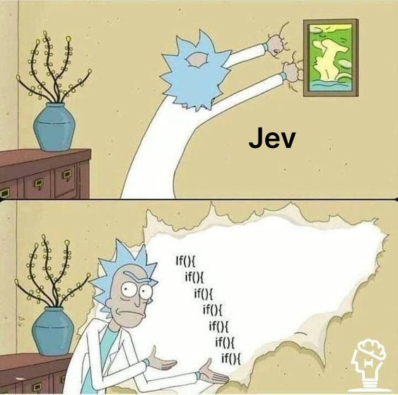
15 SEPTEMBER 2026 · TYPESAFE AI
Two weeks ago, Jev entered the story.
DIOGO ALMEIDA
Former OpenAI researcher.
At TypeSafe, his team introduced Jev:
a model for structured choices,
scores and probabilities.
Language models dominated the conversation. Decision models are a different tool.
OPEN COURSE MEDIA >
TypeSafe AI, Introducing System One Models & Jev (15 Sep 2026). Diogo Almeida is a former OpenAI researcher, not an OpenAI cofounder.
16

Slide 17
TOOL CALLING
A model asks. Your software acts.
CUSTOMER
"Is size M in stock?"
MODEL REQUEST
INVENTORY API
check_stock(size="M")
>
12 available
MODEL REPLY
"Yes. Twelve are available."
Cursor Learn, Tool Calling; illustrative stock lookup. The application defines the available tool and runs it.
17

Slide 18
THE AGENT LOOP
An agent keeps going until it has a result.
GOAL
PLAN
USE A TOOL
CHECK
Book a meeting
Find a time
Read calendar
Slot found?
>
>
>
FEEDBACK: observe the result; revise the plan
Human permission sets the boundary for sending, spending and publishing.
Conceptual agent loop based on Cursor Learn and official coding-agent guidance; human approval still governs consequential actions.
18

Slide 19
03 / 05
AGENTIC COMMERCE
When software can spend.
An agent can have payment access, a budget and a job to finish.
COURSE 4 · 0205EE

Slide 20
AGENTIC COMMERCE
HTTP 402: the web asks to be paid.
402
01
Agent requests data
Within a budget you approved
02
Service responds 402
PAYMENT REQUIRED
Price + payment instructions
1997 · HTTP/1.1
03
Agent pays; work continues
Reserved; no payment flow.
Payment proof unlocks the result
x402 proposes one now.
FOUR PROTOCOLS · FOUR DIFFERENT JOBS
x402
paid API access
AP2
payment authorization
ACP
merchant checkout
UCP
discovery to checkout
Sources: RFC 2068 (January 1997) §10.4.3; RFC 9110 §15.5.3; x402; Google AP2 and UCP; Stripe/OpenAI ACP.
20

Slide 21
PERMISSION BEFORE PAYMENT
Give the agent a wallet with a limit.
EUR 50
MAX PER CALL
No surprise EUR 30 API request.
AVAILABLE TO THE TASK
SESSION BUDGET
Stop when the cap is reached.
The wallet pays for approved services.
APPROVAL GATE
Nothing beyond the rules.
Ask before a product order.
TRANSACTION LOG
Show what was bought and why.
The person sets the authority. The agent acts inside it.
Coinbase Agentic Wallet docs: per-call and per-session limits; Google AP2: verifiable authorization. Example amounts are illustrative.
21

Slide 22
MACHINE-TO-MACHINE COMMERCE
Agents can buy services from other agents.
YOUR AGENT
SPECIALIST SERVICE
Needs a market brief.
Returns the data.
REQUEST
402 + PRICE
PAYMENT
EUR 0.20 research
+ EUR 0.40 compute
= a finished brief
A paid API can be the seller. A wallet and protocol make the handoff possible.
x402 protocol and Coinbase Agentic Wallet paid-service documentation. Values are illustrative, not service prices.
22

Slide 23
YOUR BUSINESS, ONE CONCRETE JOB
The agent can research, pay and bring back options.
OWNER'S BRIEF
Find three packaging suppliers.
Max EUR 3 for data. Ask before sample orders.
01
Research supplier options
02
Pay for a useful dataset
03
Compare price, fit and evidence
04
Request approval for a sample order
The agent brings back a decision. The owner approves the consequential purchase.
Illustrative supplier-research workflow. x402: paid API call; AP2: payment authorization; human approval for any order.
23

Slide 24
04 / 05
THE CLASS CHALLENGE
What will your team build?
Choose one useful workflow. Show the prototype and the evidence.
ALSO · INDIVIDUAL QUIZ · ALLOW 30 MIN TO 1 HOUR MAX
COURSE 4 · 0205EE

Slide 25
THE COURSE CHALLENGE
What will it take to pass?
FIRST
Every student has a GitHub account and joins a team project.
THEN
Your commits show what you contributed and how the project improved.
SHOW US
Who is the target audience? What is your goal?
What is the clear call to action?
We assess the work behind the commits, not just the count.
Official module: 80% portfolio · 20% participation · at least 5.5 in each.
Class evidence checklist; formal assessment remains 80% portfolio and 20% participation, with at least 5.5 in each part.
25

Slide 26

YOUR COURSE HOME
Open ConnectEA and find the assignment.
https://connectea-course-hub.vercel.app
1. Find your team and project.
2. See public GitHub activity.
3. Open the final assignment.
Commits show changes; your portfolio explains the learning.
SCAN TO OPEN
ConnectEA course hub; QR points to the stable course URL.
26

Slide 27
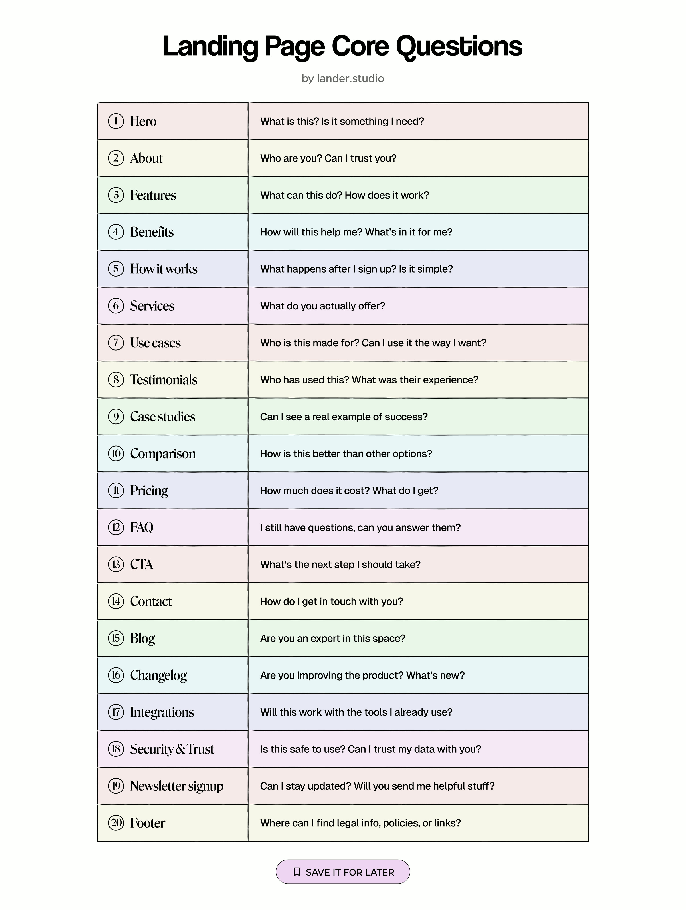
BUILDING A WEBSITE
A landing page should answer the buyer in order.
WHAT IS IT?
A clear hero and promise.
IS IT FOR ME?
Audience, use case and benefit.
CAN I TRUST IT?
Real proof and honest answers.
WHAT NEXT?
How it works and one clear action.
WHAT DOES IT COST?
Price and terms when relevant.
Start with the questions your own customer actually asks.
OPEN COURSE MEDIA >
User-supplied lander.studio reference sheet; the five questions here are an instructional summary.
27

Slide 28
05 / 05
THE CREATOR STUDIO
Automated content creation
One idea can become images, video, sound and a useful story.
COURSE 4 · 0205EE

Slide 29

CREATOR TOOL SPOTLIGHT
SOTA app for AI content creation
A creative suite for making
and transforming image and video content.
GENERATE
Create images and video
DIRECT
Use tools, presets and templates
REFINE
Edit, extend and make variations
H
HIGGSFIELD
Try it as a workflow: brief → generate → review → improve.
SOUL
CINEMA STUDIO
SUPERCOMPUTER
Judge the result against the audience, message, rights and real call to action.
Higgsfield official: higgsfield.ai/apps and higgsfield.ai/supercomputer-intro · features and access can change.
29

Slide 30
THE NEW CONTENT STACK
One person can now direct a whole production pipeline.
IDEA
->
RESEARCH
->
SCRIPT
->
IMAGE
->
VIDEO
->
VOICE
->
MUSIC
->
EDIT
->
DISTRIBUTE
The human brings direction, taste, and the final review.
A creator can select different tools for each stage; no single model needs to do everything.
30

Slide 31

AI VIDEO · 2023
The early clips could barely hold a face together.
FACE
Features shift across frames.
OBJECT
Hands, fork and food merge.
MOTION
The action has little continuity.
Watch it, then compare a recent clip. What improved?
WATCH THE EVOLUTION REEL >
OPEN COURSE MEDIA >
2023 ModelScope text-to-video example; original creator post via r/StableDiffusion.
31

Slide 32
FIRST, CHOOSE WHO IT IS FOR
A niche gives the content a point of view.
FOR EVERYONE
"People who buy food"
FOR SOMEONE
Design-conscious home cooks
who love playful dinner parties.
Who is the ideal customer - and where do they spend time?
Illustrative creative strategy for the fictional potato campaign.
32

Slide 33
SIX WAYS TO CREATE
Start with what you have. Choose what to make.
INPUT
OUTPUT
EXAMPLE
TEXT
→
IMAGE
Create a campaign still
IMAGE
→
IMAGE
Keep the product; change the scene
TEXT
→
VIDEO
Describe a moving scene
IMAGE
→
VIDEO
Animate a chosen first frame
IMAGE
→
3D
Turn a product view into an object
TEXT / VOICE
→
AUDIO
Make narration, music or effects
One campaign can combine several routes.
Capability map. The following slides show model examples and where inference can run.
33

Slide 34
WHERE DOES INFERENCE HAPPEN?
You can call a model, rent a GPU, or run one at home.
HOSTED MODEL · FAL
RENTED GPU · RUNPOD
LOCAL · COMFYUI / LTX
CHECK EVERY NODE
Privacy depends on where every step actually runs.
fal: hosted model inference; RunPod: GPU Pods and endpoints; ComfyUI: workflow interface. ComfyUI API nodes may still call cloud services.
34

Slide 35
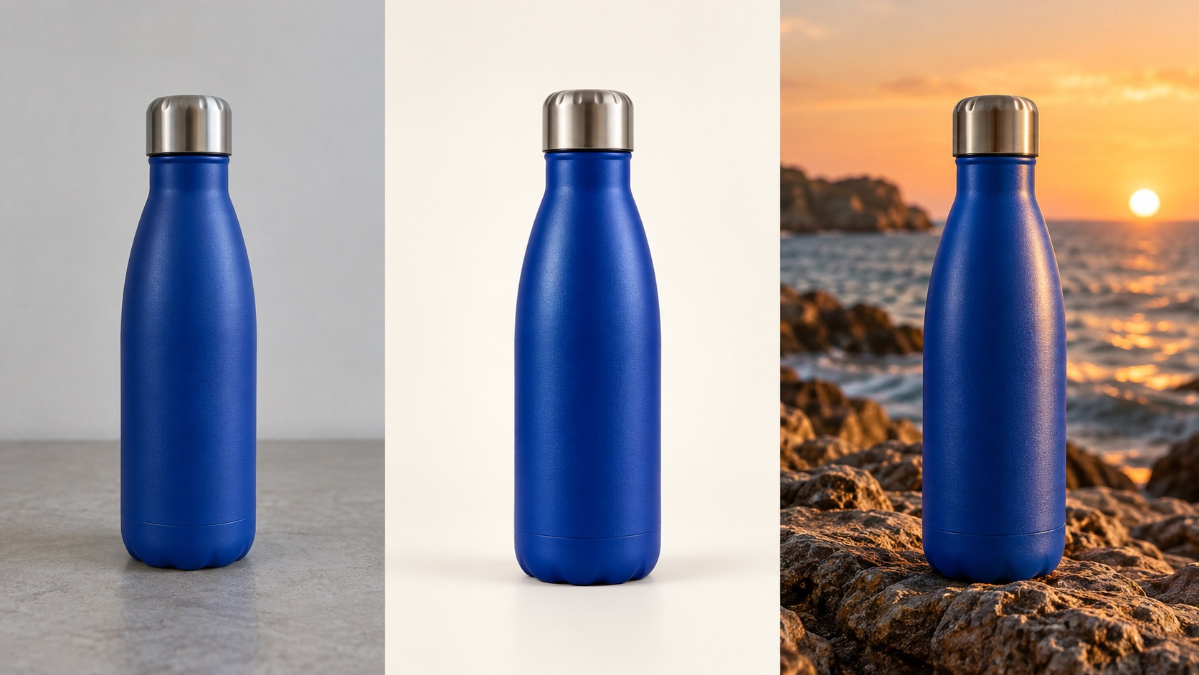
IMAGE CREATION
Two image jobs. Choose the input first.
TEXT TO IMAGE
Describe a new shot.
GPT Image · Nano Banana · FLUX
IMAGE TO IMAGE
Keep the product; change the scene.
GPT Image · Nano Banana · FLUX Kontext
REFERENCE
STUDIO
CAMPAIGN
Local examples: FLUX.2 klein and Stable Diffusion 3.5.
Model families are examples; availability and licenses change. Bottle sequence is illustrative AI-generated imagery.
35

Slide 36
MODEL MENU · MOTION + 3D
A still can become a clip or a 3D object.
IMAGE → VIDEO
Hosted
Veo 3.1 · Wan 3.0 · MiniMax H3 · FLUX 3
Local
LTX 2.5 Fast · Wan2.2 TI2V-5B
IMAGE → 3D
Hosted
Meshy 7.1 · Rodin
Local
TRELLIS.2 · Hunyuan3D 2.1
Also try text → video. Check hardware, access, region and licenses before self-hosting.
Examples checked Sep. 2026. Vendor documentation; check access and model licenses.
36

Slide 37

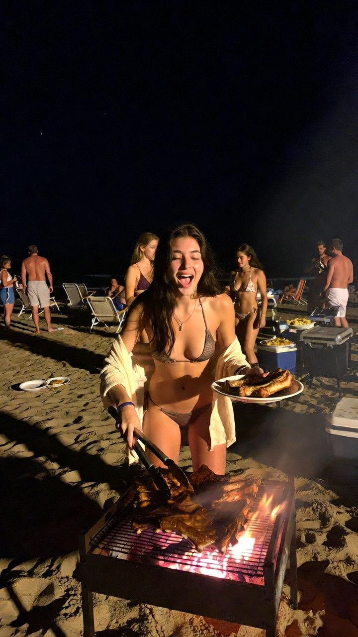
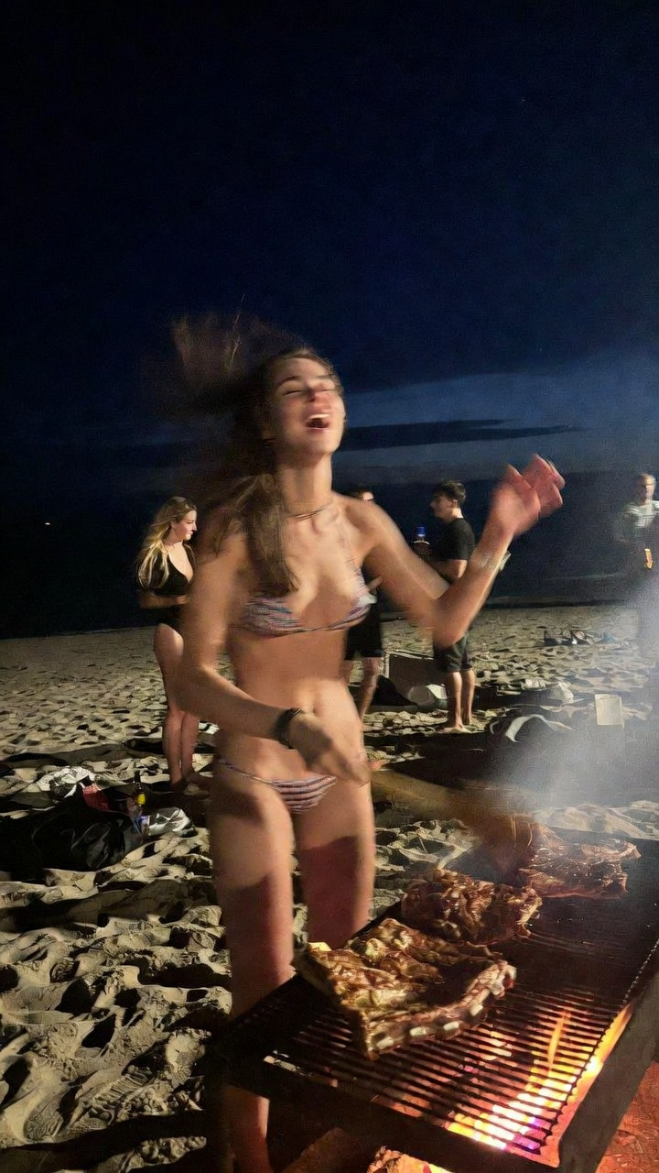
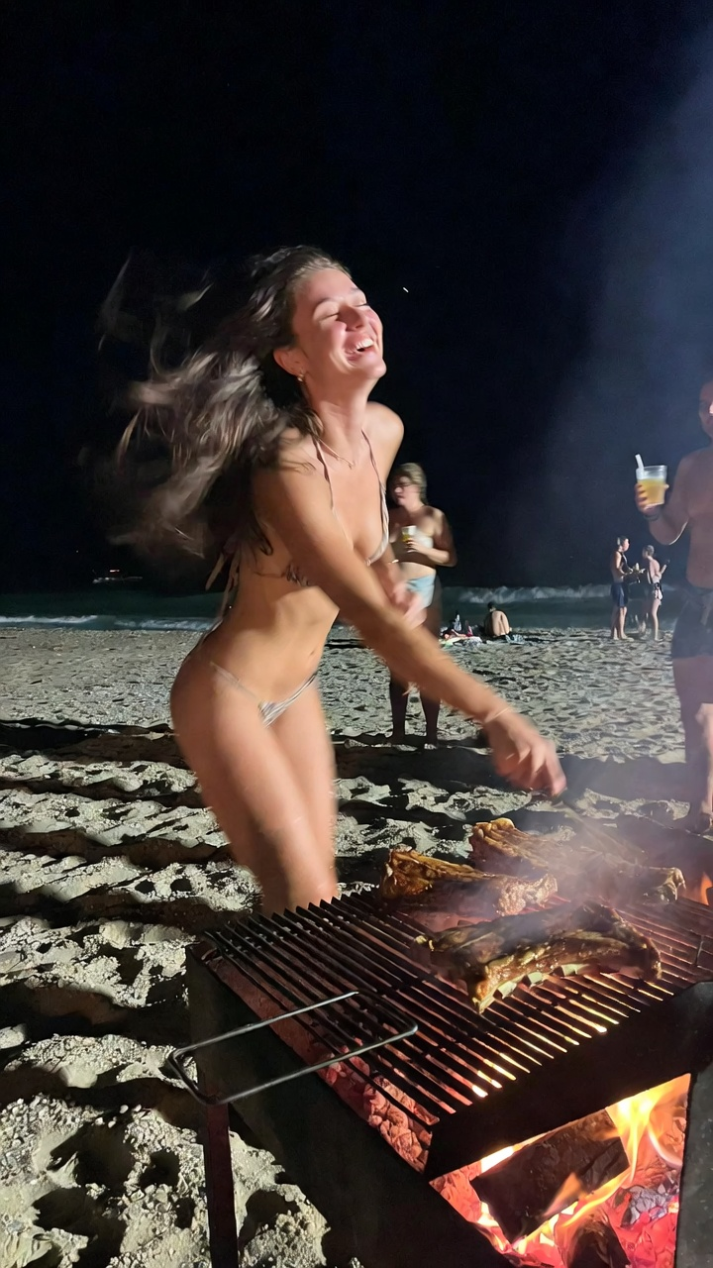
REALISTIC CONTENT
Photorealism is a look. What do you trust?
Check hands, food, background people and continuity before making a claim.
OPEN COURSE MEDIA >
Four user-supplied image examples; their origin and generation method are unverified.
37

Slide 38
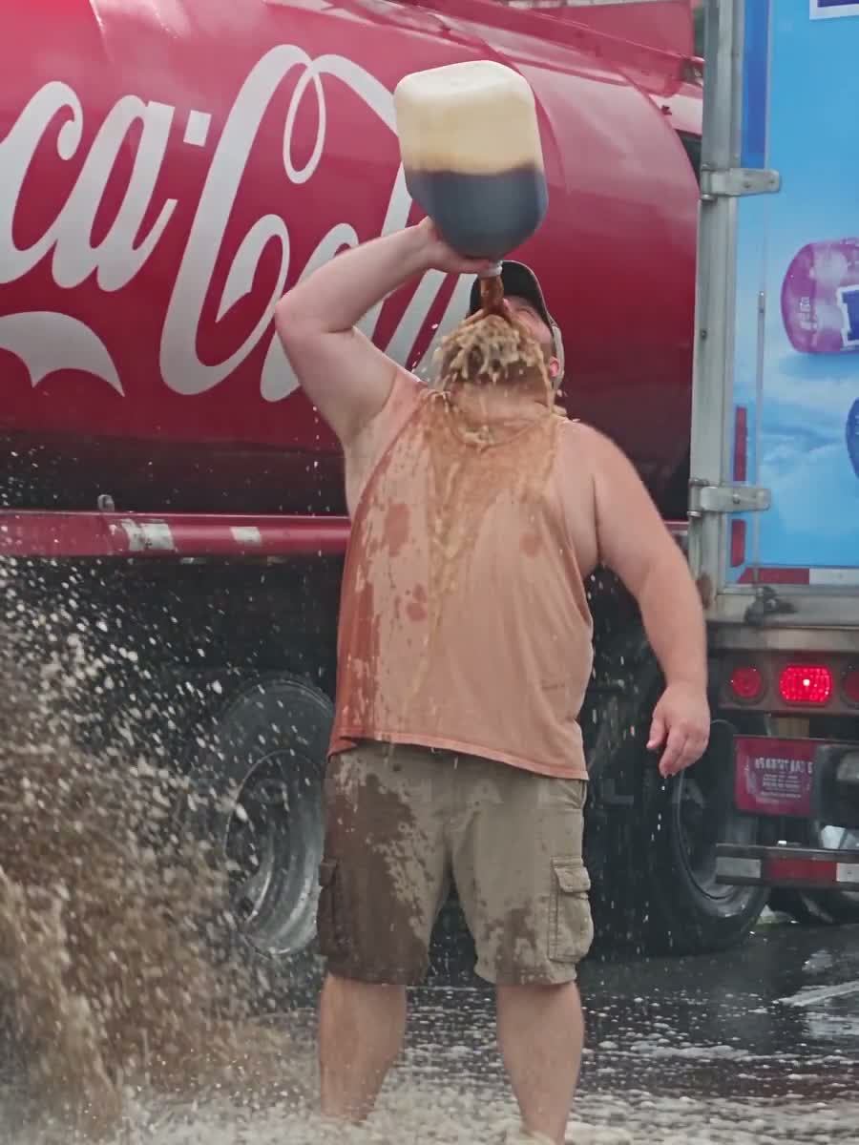
IS THIS REAL?
A spectacular clip invites a second question.
THE HOOK
A familiar phone-video look.
THE EVENT
A giant reaction at road scale.
THE CHECK
Source, context and physical clues.
Watch the 30-second clip in Course media.
OPEN COURSE MEDIA >
User-supplied cola and Mentos clip; origin and authenticity have not been verified.
38

Slide 39
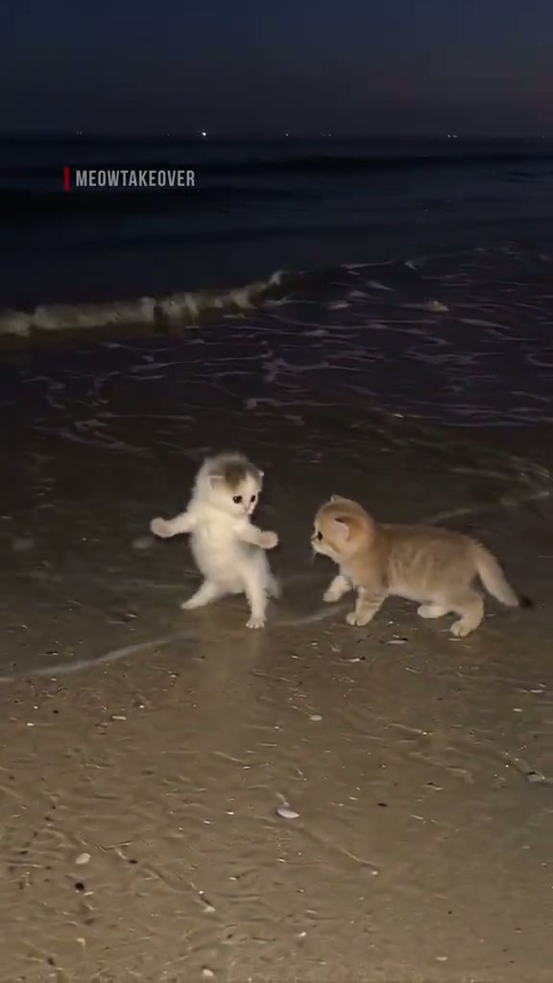
ATTENTION IS NOT THE GOAL
Why do dancing cats stop the scroll?
MOVEMENT
A familiar subject does something unexpected.
Watch the eight-second clip in Course media.
Then ask: did the right customer care?
OPEN COURSE MEDIA >
User-supplied @themrealeditsz clip; TikTok Creative Codes on hooks, movement and sound.
39

Slide 40
CONTENT ANGLES · TEST THEM
Negative hooks can win the click. Earn the trust.
NEWS HEADLINES
+2.3% click-through per negative word in one large field study.
NEGATIVE TENSION
OTHER ANGLES
MISTAKE
The step people skip
TRANSFORMATION
Before and after, with proof
HIDDEN COST
What this habit costs
COMPARISON
A versus B on one criterion
FAILED ATTEMPT
I tried X; here is what failed
DEMO
Watch the process unfold
MYTH
The advice I stopped following
IDENTITY
For people who...
Test saves, qualified clicks and action. A click is not a customer.
Nature Human Behaviour (2023): Upworthy news-headline RCTs, +2.3% CTR per negative word. This is not an ad-conversion claim; TikTok creative guidance.
40

Slide 41


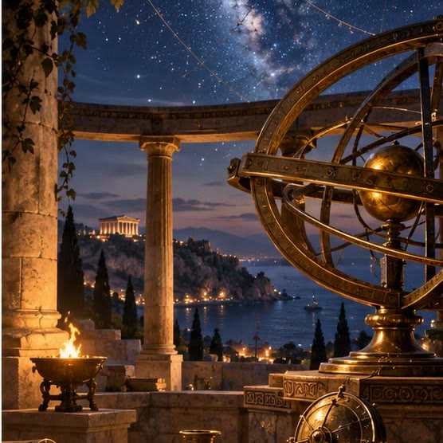
CONTENT EXAMPLES · NICHE + FORMAT
Give a niche its own visual world.
TRUE CRIME
FINANCE EDUCATION
HISTORY
3D evidence room
Gameplay economics
Cinematic reconstruction
AI-generated illustrative concepts. True-crime, finance and historical claims still require independent source checks.
41

Slide 42

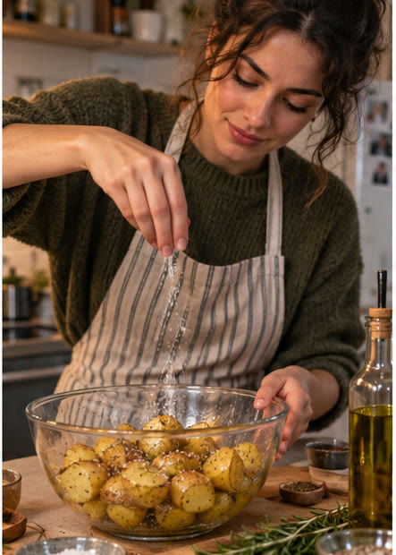
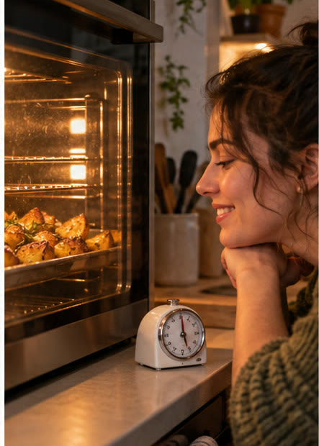
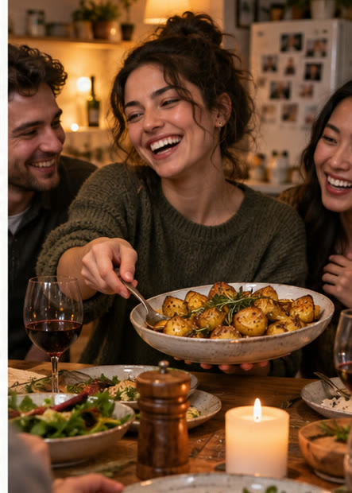
CONTENT EXAMPLE · FOUR BEATS
Let the viewer feel the change.
01 · PROBLEM
02 · TRY
03 · TIME
04 · PAYOFF
Dinner falls flat
Season the potatoes
Let the work happen
Share the result
The ending must answer the opening. Support real claims with evidence.
Four-frame illustrative AI storyboard for a fictional potato campaign; verify any factual product claim.
42

Slide 43
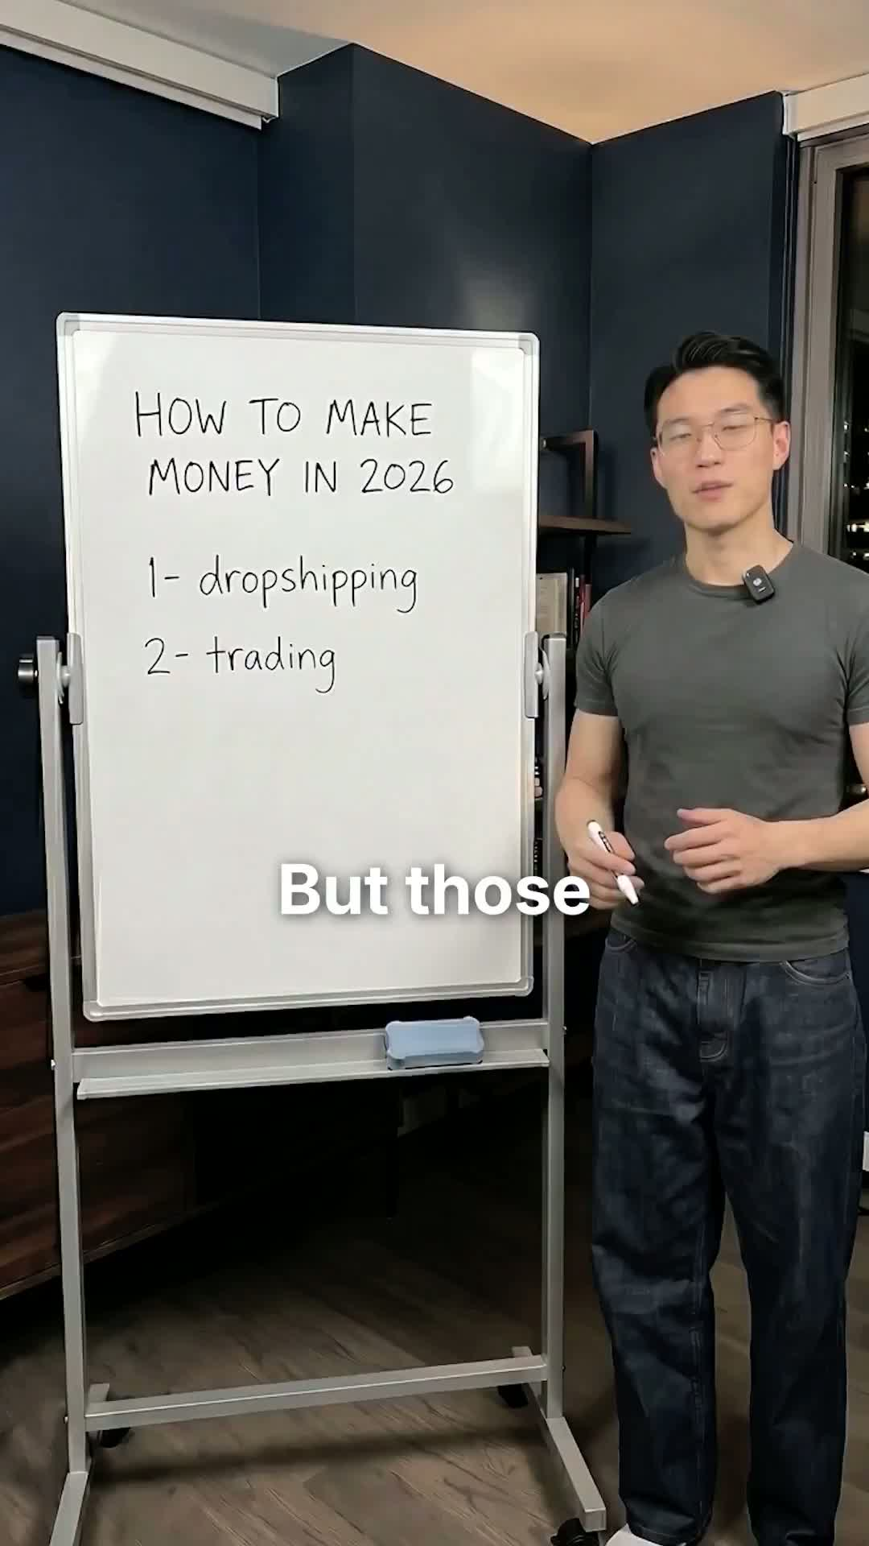
GOOD CONTENT FORMATS
A whiteboard can make a niche idea easy to follow.
ONE TOPIC
Make the question visible.
ONE DRAWING
Build the explanation as you speak.
ONE TAKEAWAY
Leave the viewer with a clear idea.
Watch the example in Course media; check every factual claim.
OPEN COURSE MEDIA >
User-supplied whiteboard clip; discuss its format, not its financial claims.
43

Slide 44
FROM BRIEF TO CAMPAIGN
One brief guides the whole campaign.
THE BRIEF
SAME DIRECTION, FOUR OUTPUTS
AUDIENCE
Design-conscious home cooks
01
02
03
04
PROMISE
IMAGE
VIDEO
SOUND
EDIT
Make a potato feel special
Hero still
10-sec clip
Voice + music
Story + CTA
TONE
Elegant · playful · a little absurd
HUMAN REVIEW
ACTION
Does every asset fit the audience, promise and action?
Visit the product page
The brief is the through-line. The tools produce the pieces.
Illustrative campaign brief; practical creative direction for a fictional potato campaign.
44

Slide 45
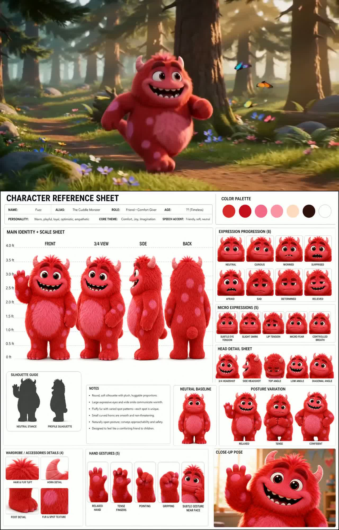
CHARACTER CONSISTENCY
A character sheet keeps the same hero recognizable.
LOCK THE LOOK
Shape · color · face · details
SHOW THE ANGLES
Front · side · back · expressions
REUSE THE SHEET
Give every shot the same reference
CHECK THE RESULT
Look for drift in each generation
Watch the red character change scenes while its design stays familiar.
OPEN COURSE MEDIA >
User-supplied red-character clip; a reference sheet reduces but cannot eliminate identity drift.
45

Slide 46
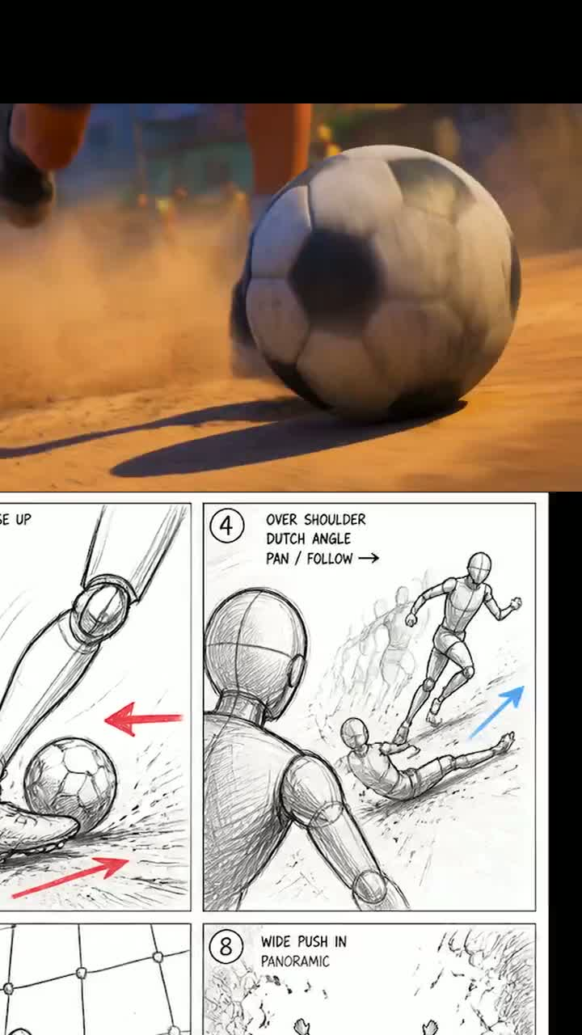
STORYBOARD FIRST
Plan the camera and action before rendering.
PANELS
What does each shot show?
CAMERA
Where does the view move?
ACTION
What changes between shots?
OUTPUT
Did the rendered clip follow the plan?
A storyboard is a control input, not a guarantee.
OPEN COURSE MEDIA >
User-supplied ComfyUI / Seedance 2.0 example; output can diverge from the storyboard.
46

Slide 47
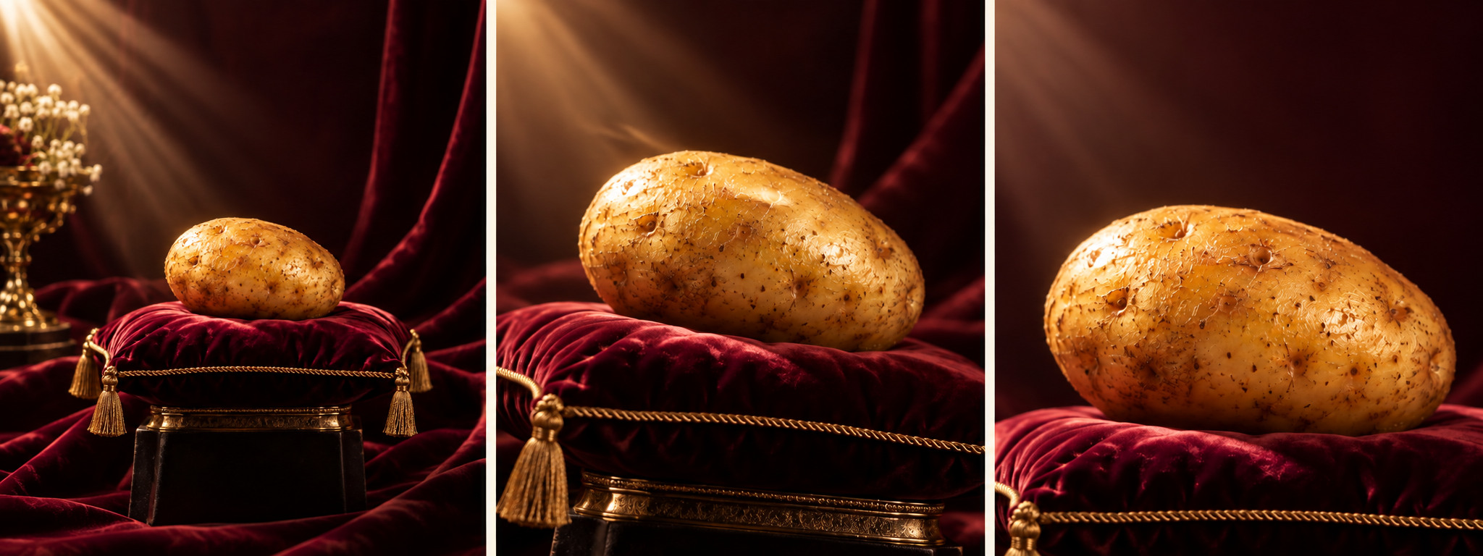
PROMPTING FOR VIDEO
A good prompt reads like a shot plan.
SUBJECT
The same potato on a velvet pedestal
0-4 SEC
Slow camera push; warm studio light
4-8 SEC
A hand lifts it; show texture close up
8-12 SEC
Hero frame; space for a later headline
LOCK: same product · natural motion · no generated text
VIEW PROMPT EXAMPLES >
Prompt structure informed by Seedance Prompts guides; fictional potato example written for this course.
47

Slide 48
ONE BRIEF · IMAGE · MOTION
Direct the campaign from still to video.
01 DIRECT THE STILL
Subject · scene · look · frame · constraints
Potato on velvet pedestal.
Elegant studio light; portrait crop;
space for copy; no invented claims or logos.
02 DIRECT THE MOTION
0-3s
Slow camera push toward the pedestal
3-7s
Light sweeps across the potato
7-10s
Hold a clean frame for the call to action
THE BRIEF
Home cooks · make a potato feel special · visit the product page
Review: does the output keep the brief, look credible and make the next action clear?
Prompting principles: OpenAI Academy, Creating images with ChatGPT; Runway, Image to Video Prompting Guide. Example campaign is fictional.
48

Slide 49
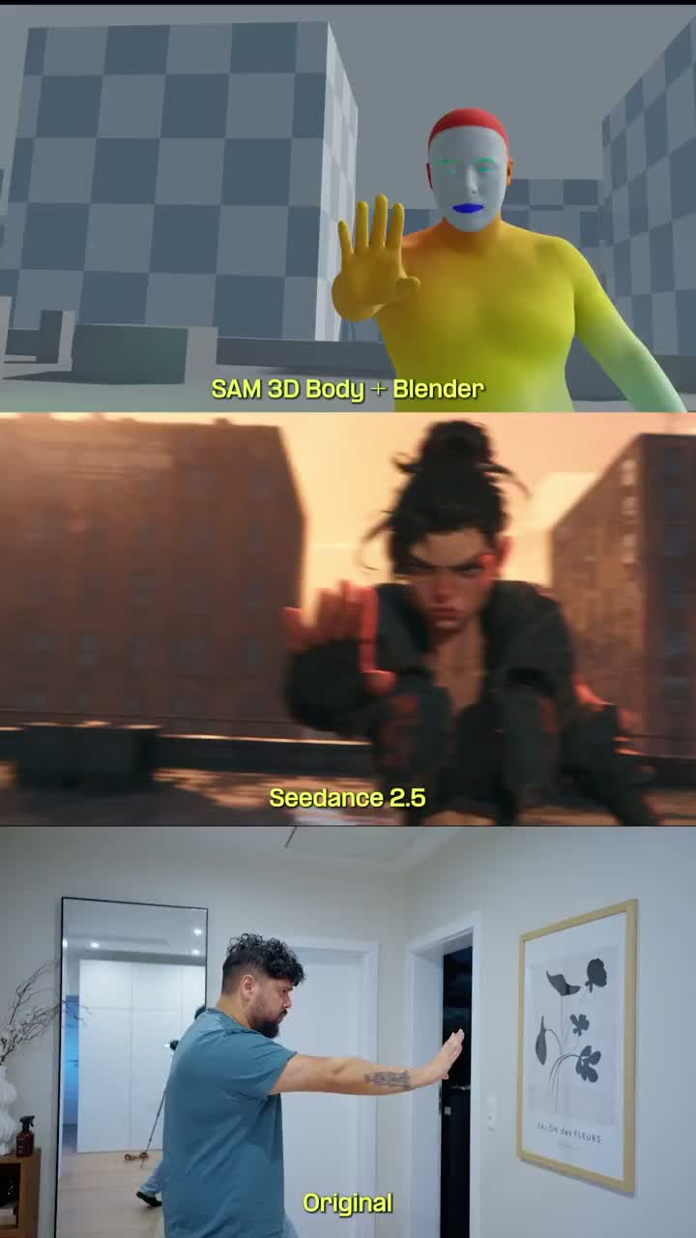
MOTION CONTROL
One performance can guide several looks.
SOURCE VIDEO
The performer supplies the movement.
3D BODY GUIDE
A reconstructed body helps track pose.
NEW CHARACTERS
Generation changes the appearance.
Watch the original / 3D body / generated-character comparison.
OPEN COURSE MEDIA >
User-supplied ComfyUI example; SAM 3D Body estimates a 3D human mesh and is one part of this workflow.
49

Slide 50
ONE RECORDING, MANY ASSETS
One conversation. Five useful outputs.
START WITH A REAL CUSTOMER
PODCAST
The full story, edited for clarity
What did you try?
SOCIAL CLIP
Where did you get stuck?
One problem and one useful answer
EMAIL
What finally helped?
The insight + a practical next step
ARTICLE
Answer the question people search
Record with permission. Mark the best moment.
AD
Keep their words and context accurate.
A hook to test, with a clear action
TRY IT / Choose one interview moment. Write a clip hook and an email subject.
50

Slide 51
VIDEO ANALYSIS WITH GEMINI
Turn an ad into a reusable shot plan.
ASK ABOUT A VIDEO YOU CAN SHARE
YOUR ORIGINAL VERSION
Mark the hook, problem, proof and CTA.
HOOK
Give timestamps in MM:SS.
Open on your customer problem.
Describe the camera, cuts and sound.
PROOF
Separate observations from guesses.
Show your own prototype working.
CTA
Check the analysis against the actual video.
Send viewers to your website.
CLASS DEMO / Analyse one short ad. Turn the structure into a three-shot script.
Google Gemini video understanding: ai.google.dev/gemini-api/docs/video-understanding
51

Slide 52
TREND RESEARCH
Find a pattern worth testing.
3 examples
SPOT
What repeats: opening, reveal, payoff?
from the same niche
ADAPT
How does it fit your customer problem?
Save each link, date and audience.
Look for the recurring question
TEST
in the comments.
Make one original version for your site.
Decide the signal first: clicks to your site, sign-ups, bookings or useful replies.
Suggested classroom experiment. TikTok Creative Center: ads.tiktok.com/business/creativecenter
52

Slide 53
RESEARCH TOOLKIT
Choose the tool by the question.
WHAT YOU NEED
TOOL
TAKE AWAY
Instagram post inspiration
ViralFindr
3 relevant references
UGC formats and hooks
LightReel
A pattern to test
Competitor Meta ads
GetHookd
An offer + creative angle
Facebook niche content
NicheTrafficKit
Themes for your niche
Social data for your workflow
ScrapeCreators
Public posts or comments
OUTPUT / Save the source link and explain what you will change for your product.
Official product sites: viralfindr.com · lightreel.ai · gethookd.ai · nichetraffickit.com · scrapecreators.com
53

Slide 54
01
02
03
Hook
Show the
Give a
attention
problem
useful tip
04
05
06
Demonstrate
Show the
Add a clear
your prototype
benefit
call to action

Slide 55
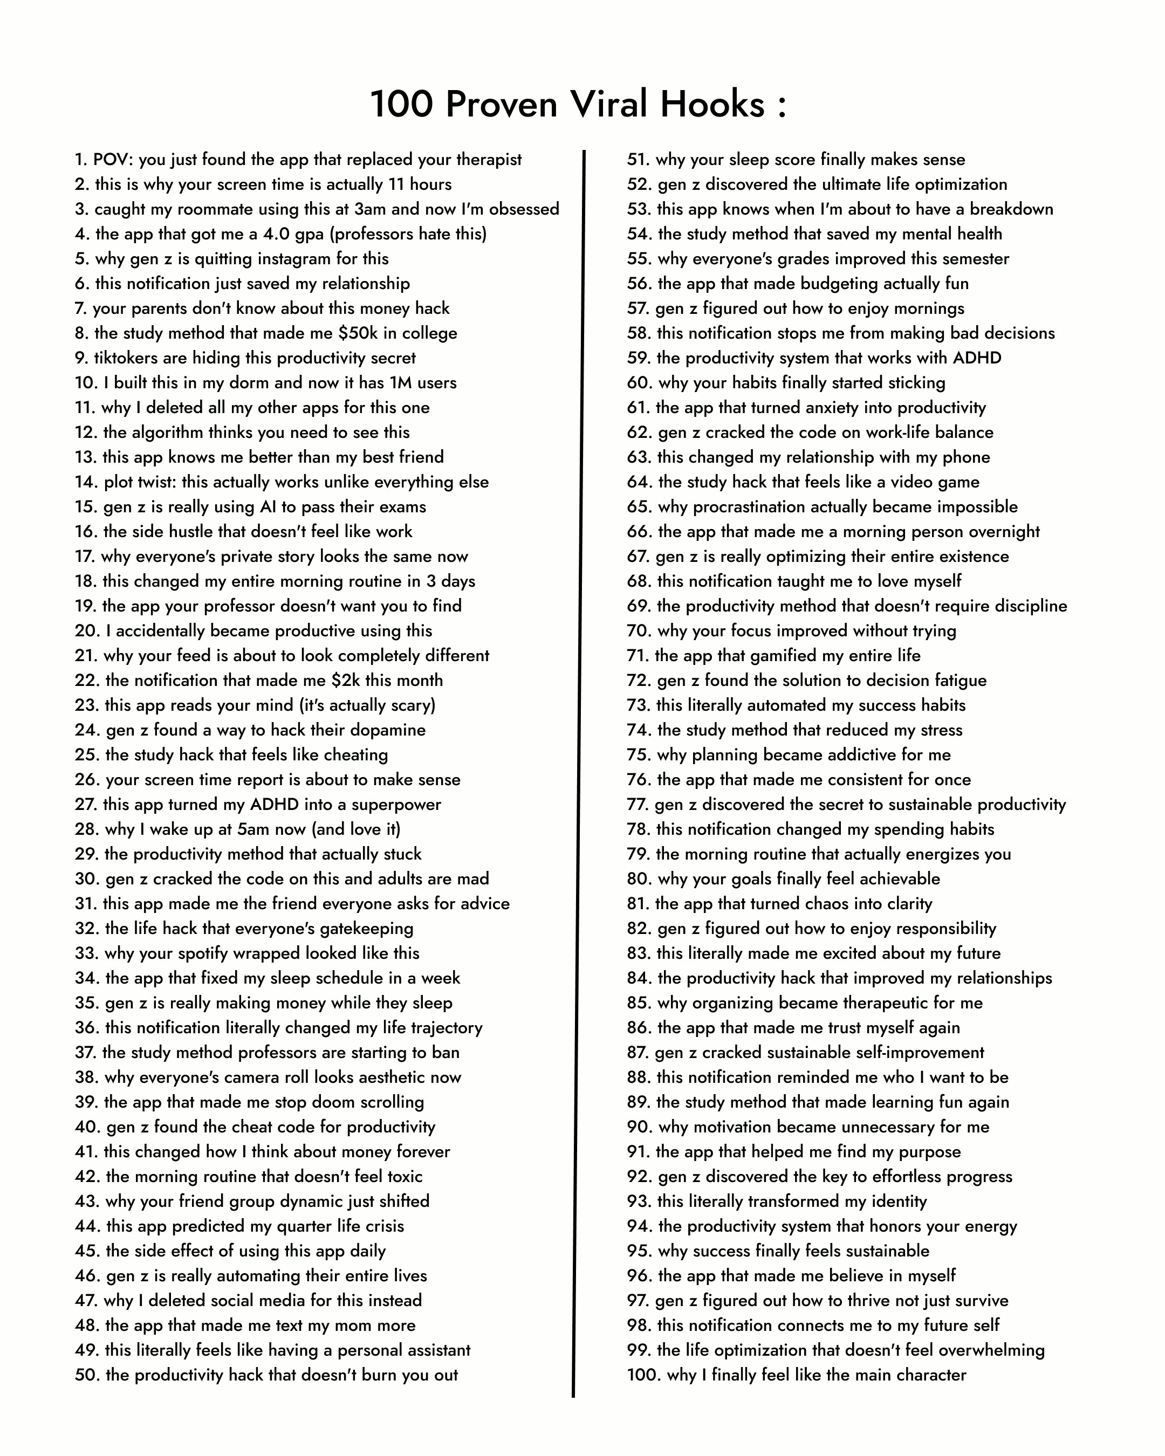
CONTENT FORMAT · HOOKS
A hook is a promise you have to earn.
POV
Put the viewer in a situation.
HOW TO
Promise one useful outcome.
CONTRAST
Show a real before and after.
SPECIFIC RESULT
Use a number only with evidence.
Rewrite for your customer. Test the opening, then check the result.
OPEN COURSE MEDIA >
User-supplied 100-hook swipe file; “proven” performance and many example claims are unverified.
55

Slide 56

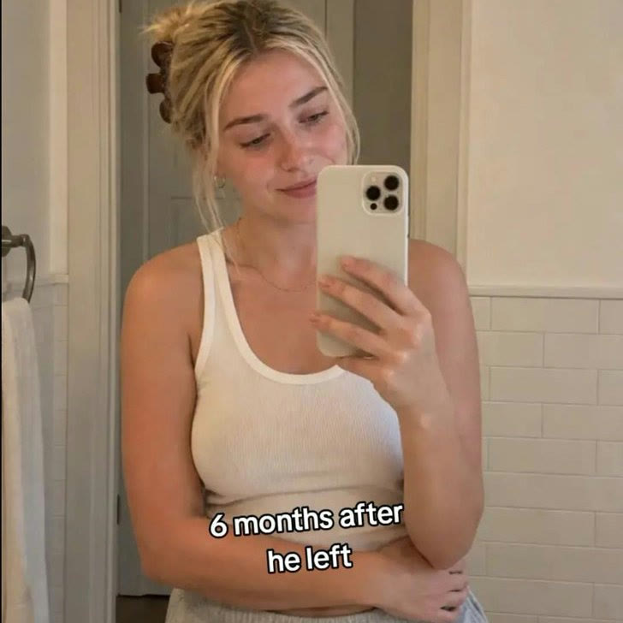
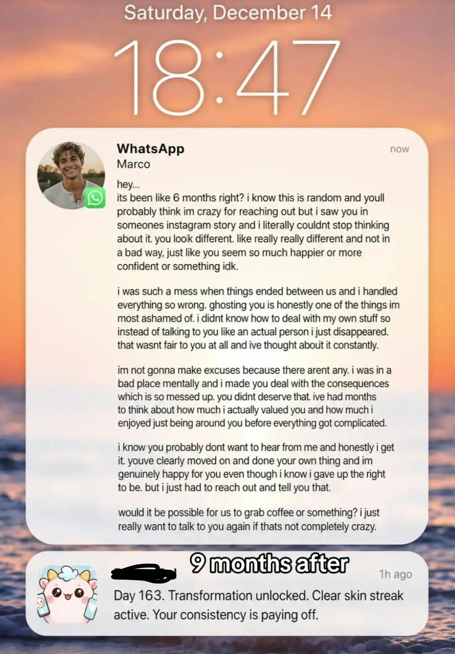
CONTENT FORMAT · TRANSFORMATION
Three frames tell a complete change story.
1 · HOOK
2 · CONTRAST
3 · PAYOFF
An emotional state
The same person, later
A next step in the story
OPEN COURSE MEDIA >
User-supplied example; depicted story and results are unverified. Treat as format analysis, not product evidence.
56

Slide 57
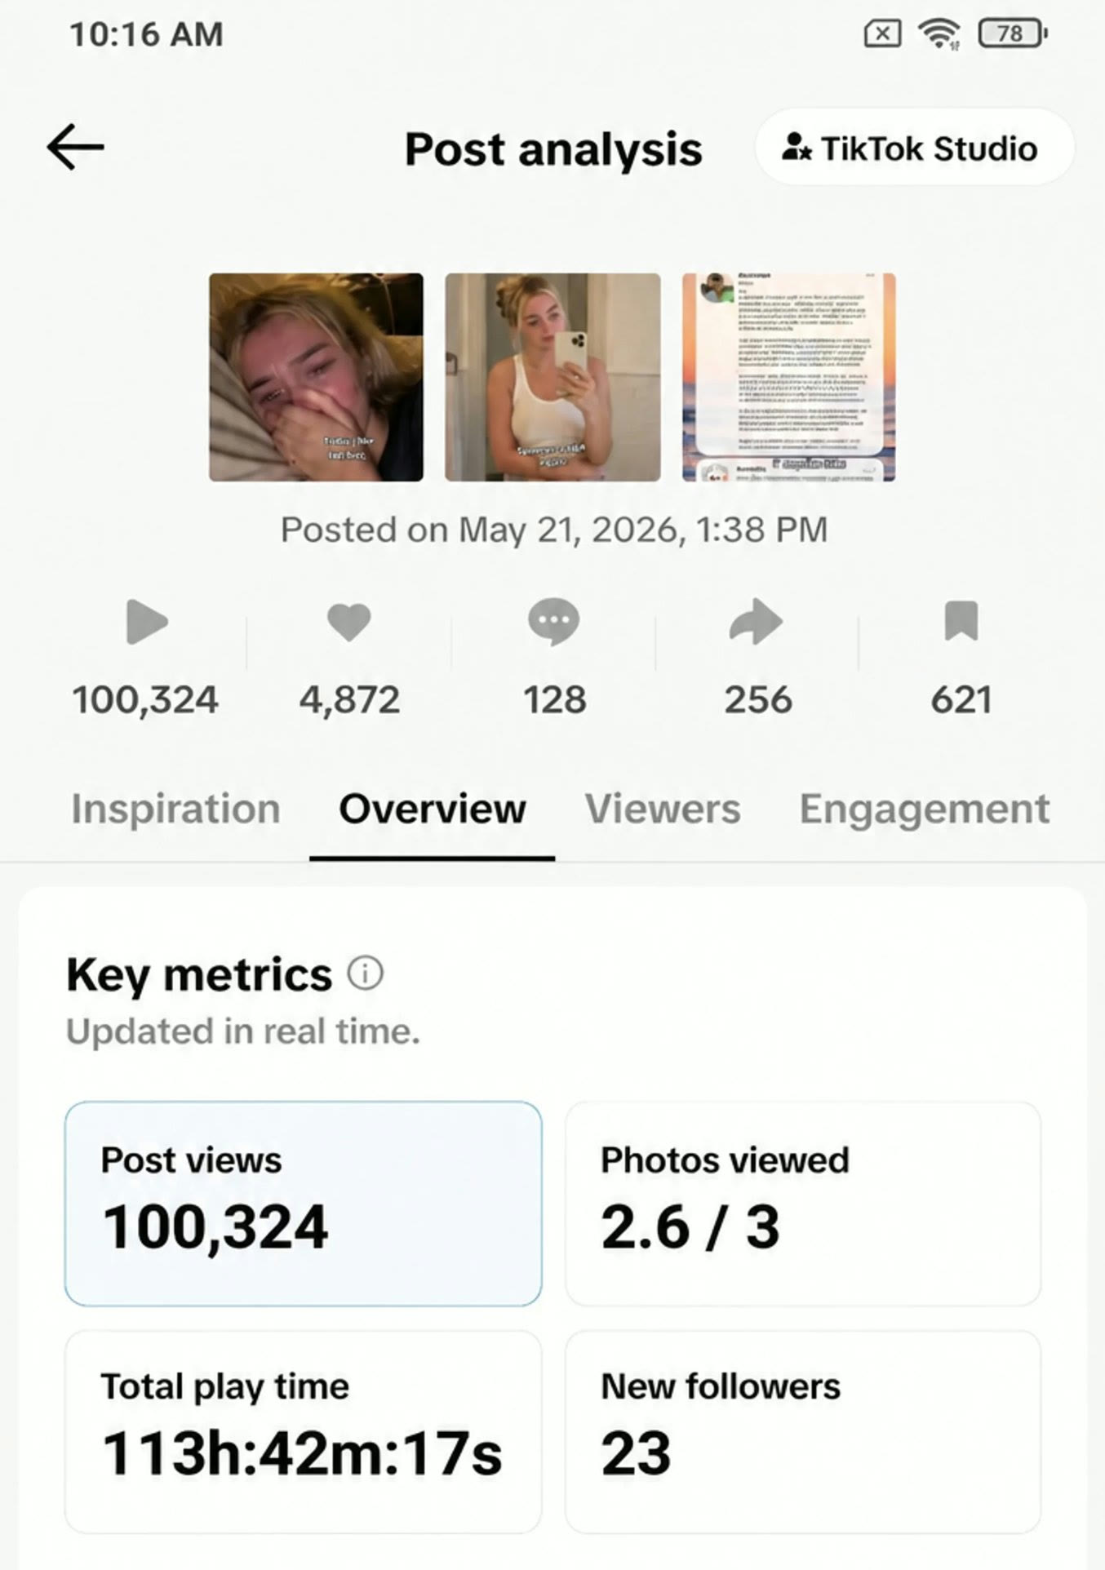
READ THE RESPONSE
Views alone do not tell the whole story.
VIEWS
100,324
SAVES
621
NEW FOLLOWERS
23
Ask: did the right audience take the intended action?
User-supplied TikTok analytics screenshot; figures and attribution were not independently verified.
57

Slide 58
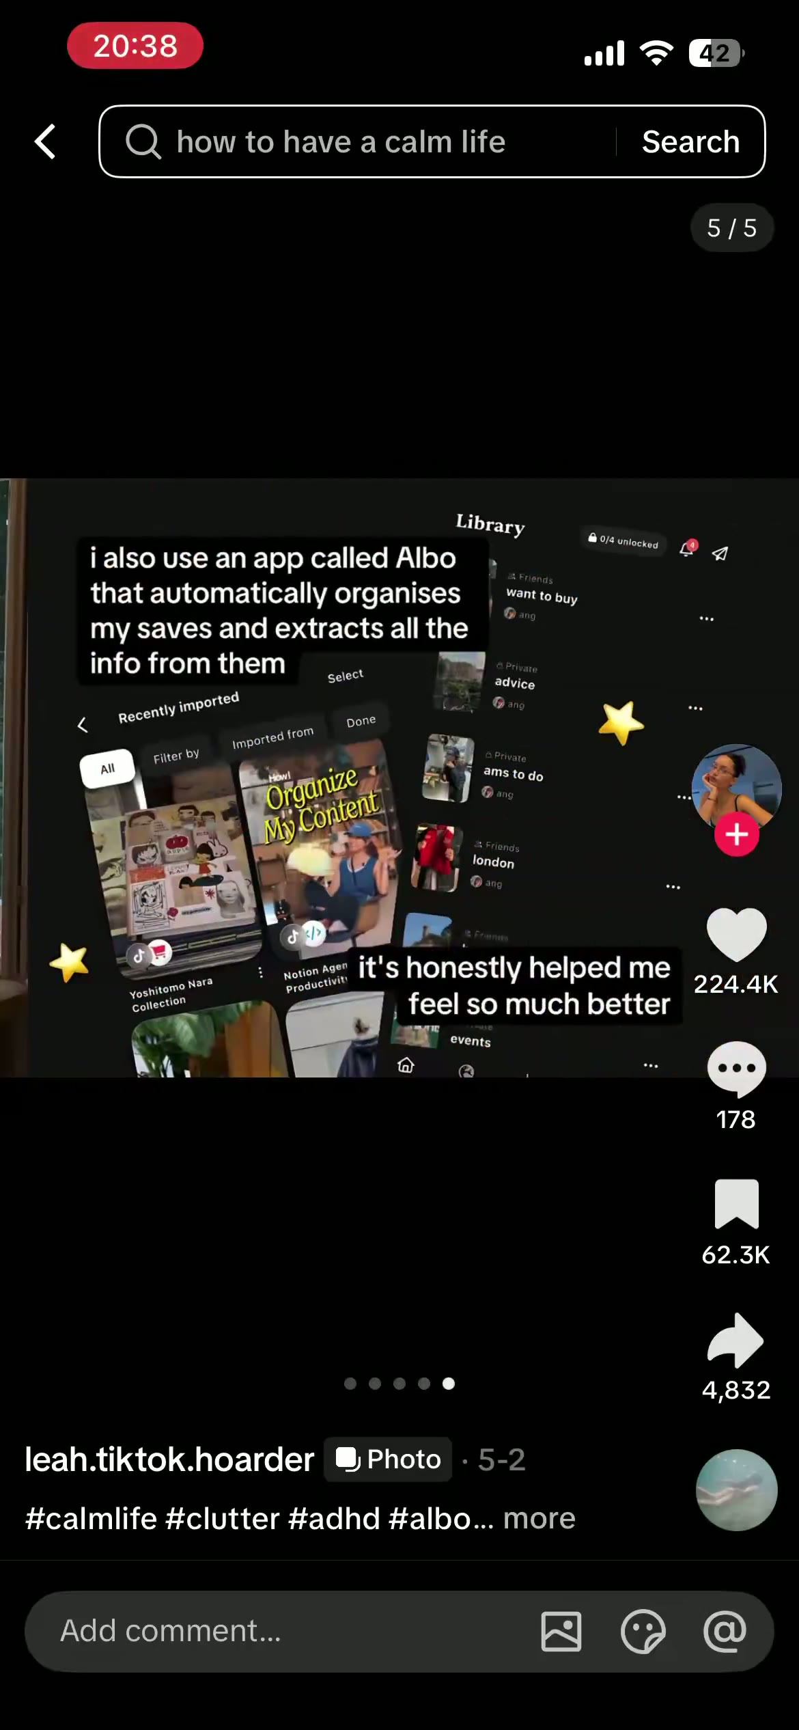
CONTENT FORMAT · HOW TO
Teach first. Let the app solve the last step.
1 · FACE
A person anchors the first frame.
2 · HOW TO
Promise one useful outcome.
3 · ADVICE
Give 3-4 actionable slides.
4 · APP CTA
Offer the app as the next step.
Adapt the structure; use your own face, advice, assets and proof.
OPEN COURSE MEDIA >
User-supplied Adria Martinez clip; performance claims are the creator’s observation, not a universal result.
58

Slide 59
A SIMPLE POSTING EXPERIMENT
Test one change. Learn what to repeat.
YOUR QUESTION / Which opening brings people to our product page?
01
02
03
PLAN
PUBLISH
COMPARE
Write two different hooks.
Use one channel.
Record impressions and clicks.
Keep the demo, offer
Give each version the same
Compare the click rate.
and CTA the same.
time to collect results.
Repeat the promising angle.
CLICK RATE = LINK CLICKS / IMPRESSIONS x 100%
Keep a log: version, date, impressions, clicks, sign-ups. Small samples give early clues.
59

Slide 60
DISTRIBUTE WITH A PLAN
Give every channel a clear job.
Start with the channel your customer already uses.
CHANNEL
CONTENT TO MAKE
NEXT ACTION
SOCIAL / PODCAST
A useful story or short demo
Visit the product page
SEARCH
An answer to a customer question
Explore your solution
EMAIL
A useful tip for subscribers
Try the next feature
PAID ADS
One offer + a product demonstration
Sign up or book a demo
TEAM TASK / Pick one channel, one piece of content and one measurable action.
60

Slide 61
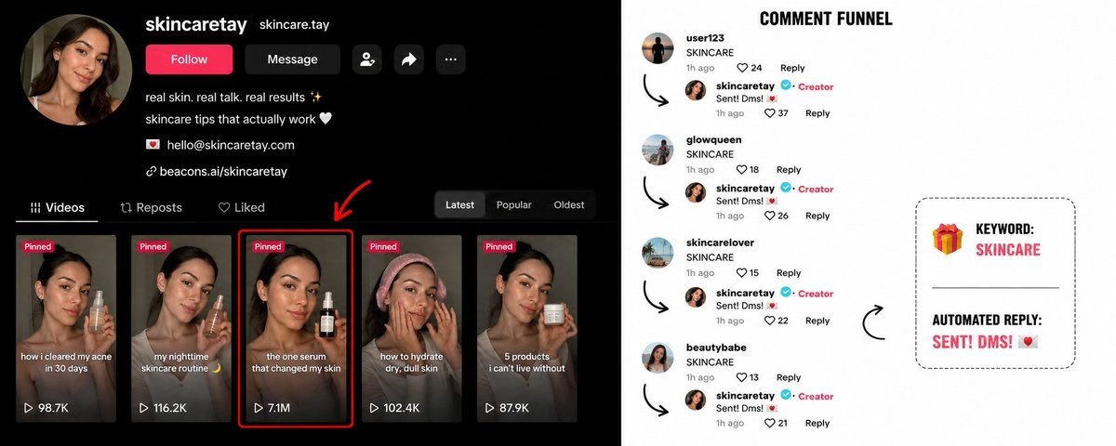
COMMENT TO DM
A keyword comment can trigger a useful reply.
OPEN COURSE MEDIA >
User-supplied funnel screenshot; comments and outcomes are illustrative, not verified performance data.
61

Slide 62
CONTENT AT SCALE
Who checks post number 3,000?
100
1
30
x
x
PAGES
POST / DAY
DAYS
3,000 posts
Every post needs an owner,
a review and a working CTA.
Discuss: where would your team become the bottleneck?
Hypothetical production scenario: 100 pages, one post per day, 30 days.
62

Slide 63
SCRIPT SYSTEM
Reuse the structure. Make the story specific.
EXAMPLE / YOUR TEAM TASK BOARD
HOOK
"Who was supposed to do this?"
PROBLEM
"Tasks disappear inside the group chat."
DEMO
Show a task getting an owner and a deadline.
CTA
"Try it with your team. Link in bio."
YOUR TURN / Change the hook for a student team and a small agency.
Use real customer language. Only promise what your prototype can do.
63

Slide 64
PRODUCTION SYSTEM
Orchestrate the work. Assign the handoffs.
STAGE
OUTPUT
HUMAN OWNER
01 / Research
One audience insight + source
Researcher
02 / Script
Hook, demo and CTA
Writer
03 / Generate
Visuals from an approved brief
Creator
04 / Edit
One finished ad with captions
Editor
05 / Publish
Checked post + working link
Reviewer
Assign names in your team. One person can own more than one stage.
64

Slide 65
QUALITY GATE / PEER REVIEW
Would you approve this ad?
Swap ads with another team. Check these four things.
01
PRODUCT
Does the demo match the working prototype?
02
CLAIMS
Can the team support every promise?
03
CRAFT
Are visuals, voice and captions consistent?
04
ACTION
Does the CTA link work on a phone?
Leave one specific fix. Name the person who approves the final version.
65

Slide 66
LEARNING LOOP
Find the drop. Choose the next experiment.
OBSERVED RESULT
QUESTION TO ASK
NEXT TEST
1,000
impressions
Did we reach the right people?
Try another audience
50
link clicks
Did the opening earn interest?
Test a different hook
5
sign-ups
Did the page make the value clear?
Simplify the CTA
5% clicked. 10% of clicks became sign-ups.
These results are clues. Change one thing, then gather more evidence.
Illustrative results, not measured campaign data. Link clicks do not establish what caused a sign-up.
66

Slide 67
THE ECONOMICS OF CONTENT
What did one usable ad actually cost?
EXAMPLE BATCH
6 approved ads
Tools + generation, including retries
EUR 20
Editing + review time
EUR 30
EUR 10
Captions + export time
EUR 10
per usable ad
TOTAL PRODUCTION COST
EUR 60
Count the retries and your time. Divide by the outputs you can actually use.
Hypothetical production budget. Time values and tool spend are examples, not market prices; media spend excluded.
67

Slide 68
CREATIVE OWNERSHIP
Show the judgment behind the output.
NOTICE
What did you learn from your actual users?
CHOOSE
What did you keep, change or leave out?
ADAPT
What improved after someone tried it?
BRING TO YOUR REFLECTION
One before-and-after example. Your decision. The evidence.
68

Slide 69
IF ANYONE CAN CREATE ANYTHING...
What becomes scarce is worth paying attention to.
IDEAS + TASTE
JUDGMENT + TRUST
AUDIENCE + DISTRIBUTION
Generation is abundant. Attention is earned.
Closing reflection on differentiation and entrepreneurial value.
69

Slide 70
COURSE 4 · FINAL THOUGHT
Combine the tools.
Make something useful.
Models + data + software + human judgment
Start with one audience and one problem worth solving.

