Slide 1

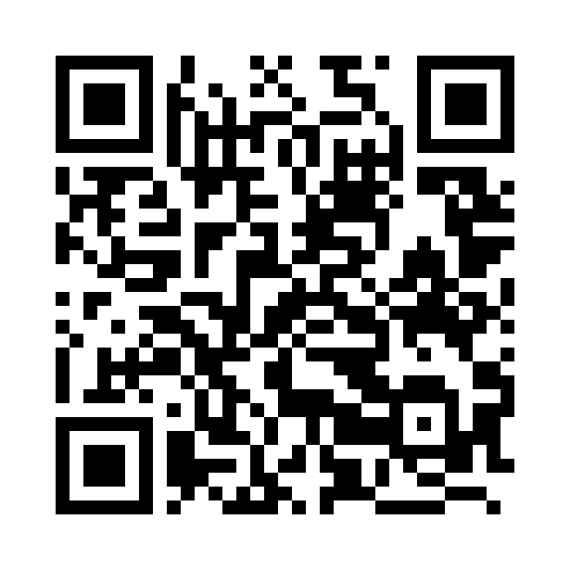
COURSE 5 / BUILDING WITH NO-CODE
From prototype
to first
clients.
Find the right people. Start useful
conversations. Show what you
learned.
Course 5
connectea-course-
hub.vercel.app/course-5/
SCAN OR CLICK TO OPEN
Course 4 editorial illustration reused; fictional scene.
CONNECTEA / COURSE 5 / 0205EE
01

Slide 2
TODAY / 180 MINUTES
Build a path from interest to evidence
01
02
03
0-40: assignment
40-90: customer, offer,
100-160: CRM, outreach,
walkthrough and evidence
lead research; then
capture. 160-180:
clinic.
10-minute break.
portfolio review.
Apply this to your own project.
CONNECTEA / COURSE 5 / 0205EE
02

Slide 3
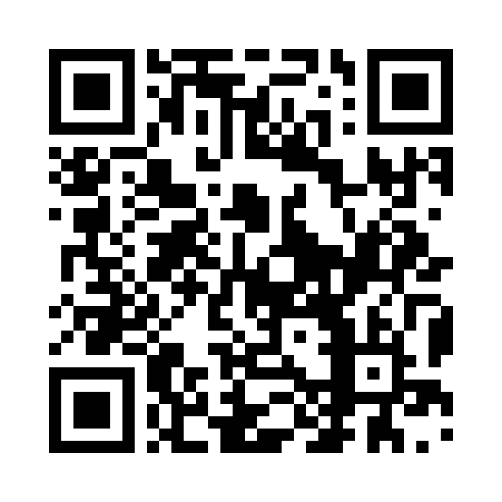
THE ASSIGNMENT
What are you actually being asked to do?
01
Build a testable digital prototype for
a real opportunity.
02
Test an assumption with people and use
what you learn.
03
Submit your evidence and your
individual reflection.
Assignment workbook
Course 5 / assignment workbook
SCAN OR CLICK TO OPEN
Visual reused from Course 4; editorial illustrations depict fictional scenes.
CONNECTEA / COURSE 5 / 0205EE
03

Slide 4
THE ASSIGNMENT
Eight required portfolio items
01
Opportunity
02
Concept
03
Live site + GitHub
04
Testing
05
Iterations
06
Tool choices
07
Your reflection
08
Ad + copy
Assignment workbook
Team prototype. Individual
Course 5 / assignment workbook
evidence and reflection.
SCAN OR CLICK TO OPEN
CONNECTEA / COURSE 5 / 0205EE
04

Slide 5
ASSESSMENT
Two assessed parts. Both must pass.
20%
80%
ACTIVE PARTICIPATION
PROTOTYPE PORTFOLIO
At least 5.5 in EACH part.
Leaderboard points do not change the grade.
CONNECTEA / COURSE 5 / 0205EE
05

Slide 6
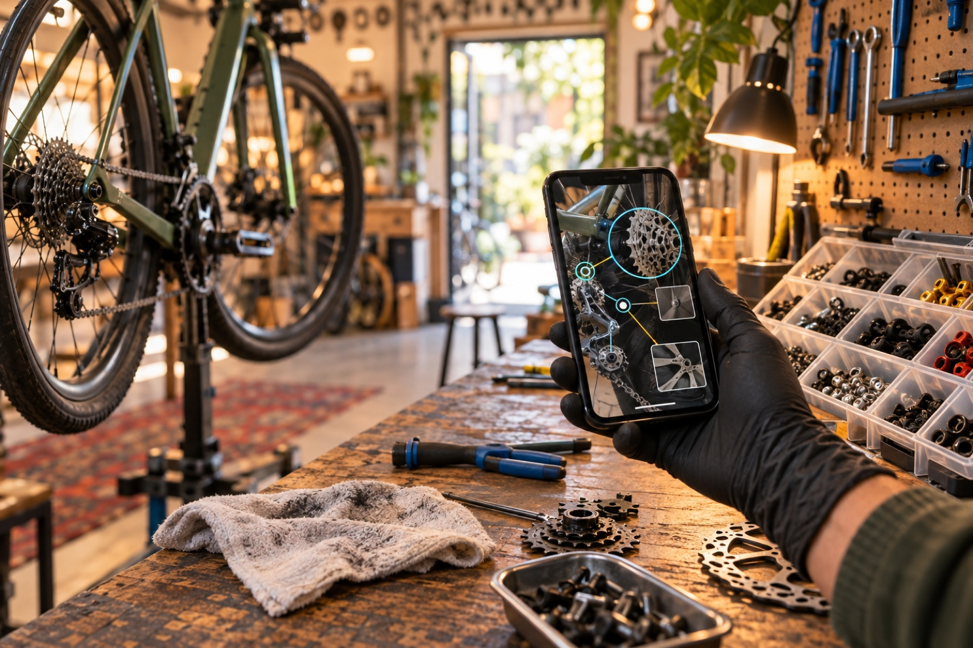
ITEMS 1 + 2
Explain the opportunity and your choice
01
Who has the problem? What happens when
it is unsolved?
02
What is your riskiest assumption about
that customer?
03
Why is this prototype a useful way to
test it?
DISCUSS > TRY > CHECK > REFLECT
Visual reused from Course 4; editorial illustrations depict fictional scenes.
CONNECTEA / COURSE 5 / 0205EE
06

Slide 7

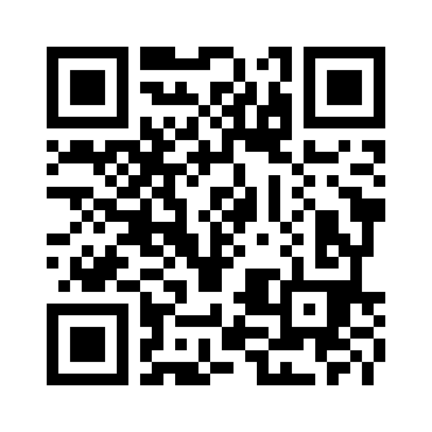
ITEM 3
A prototype must let someone do something
01
Give a specific user a specific task.
02
Make the action and its outcome
visible.
03
Share a working live link and the
matching repository.
LEGIT AGENTIC
legit-agentic.vercel.app
SCAN OR CLICK TO OPEN
Visual reused from Course 4; editorial illustrations depict fictional scenes.
CONNECTEA / COURSE 5 / 0205EE
07

Slide 8
ITEM 4
What counts as testing evidence?
01
Record the participant context, task,
date, and method.
02
Capture what happened: completion,
friction, or feedback.
03
Explain what the observation means for
your assumption.
Assignment workbook
Course 5 / assignment workbook
SCAN OR CLICK TO OPEN
Visual reused from Course 4; editorial illustrations depict fictional scenes.
CONNECTEA / COURSE 5 / 0205EE
08

Slide 9
ITEM 5
Make the before-and-after reasoning visible
OBSERVATION
CHANGE
RETEST
Two testers missed the
Move it beside the
Check whether new
enquiry action.
product details.
users finish the task.
Make the evidence > decision > check visible.
Fictional example. A planned retest must not be presented as completed.
CONNECTEA / COURSE 5 / 0205EE
09

Slide 10
ITEMS 6 + 7
Explain your tools and your own contribution
01
Tools: why this choice fits the task,
limits, and budget.
02
Contribution: what you personally did
and checked.
03
Reflection: what changed your mind and
what comes next.
Assignment workbook
Course 5 / assignment workbook
SCAN OR CLICK TO OPEN
Visual reused from Course 4; editorial illustrations depict fictional scenes.
CONNECTEA / COURSE 5 / 0205EE
10

Slide 11

ITEM 8
Your ad should lead somewhere useful
01
Name the audience, value promise, and
next action.
02
Include the creative link and the
advertisement copy.
03
Make the landing page deliver the
promise in the ad.
Assignment workbook
Course 5 / assignment workbook
SCAN OR CLICK TO OPEN
Visual reused from Course 4; editorial illustrations depict fictional scenes.
CONNECTEA / COURSE 5 / 0205EE
11

Slide 12
EVIDENCE CLINIC / 8 MIN
Replace a claim with an observation
OBSERVATION
CHANGE
RETEST
Two testers missed the
Move it beside the
Check whether new
enquiry action.
product details.
users finish the task.
Make the evidence > decision > check visible.
Fictional example. A planned retest must not be presented as completed.
CONNECTEA / COURSE 5 / 0205EE
12

Slide 13
PORTFOLIO CHECKPOINT
Find your biggest missing piece
01
Open your portfolio and inspect all
eight items.
02
Choose the gap that most weakens your
evidence.
03
Name an owner and the next action to
close it.
Assignment workbook
Course 5 / assignment workbook
SCAN OR CLICK TO OPEN
Visual reused from Course 4; editorial illustrations depict fictional scenes.
CONNECTEA / COURSE 5 / 0205EE
13

Slide 14
CUSTOMER + OFFER
Who needs this enough to respond?
01
Choose one segment, one problem, and
one situation.
02
Distinguish the user from the person
who pays.
03
Offer a small, credible next step.
DISCUSS > TRY > CHECK > REFLECT
Visual reused from Course 4; editorial illustrations depict fictional scenes.
CONNECTEA / COURSE 5 / 0205EE
14

Slide 15
TEAM EXERCISE / 8 MIN
Write your offer in one sentence
01
02
03
For [specific audience]
... we offer [useful
First step: [interview,
struggling with [problem]
outcome] through
test, enquiry, or pilot].
...
[solution].
Apply this to your own project.
CONNECTEA / COURSE 5 / 0205EE
15

Slide 16
TWO ROUTES
Match acquisition to your project
01
02
03
Business clients:
Consumer projects: invite
Both: explain fit and
research organisations
voluntary signups or user
choose an appropriate
and relevant roles.
tests.
contact route.
Apply this to your own project.
CONNECTEA / COURSE 5 / 0205EE
16

Slide 17

LEAD RESEARCH
Where could the right people be?
01
Start with introductions, referrals,
and existing enquiries.
02
Inspect relevant public business sites
and directories.
03
Use communities with permission; offer
a clear signup.
DISCUSS > TRY > CHECK > REFLECT
Visual reused from Course 4; editorial illustrations depict fictional scenes.
CONNECTEA / COURSE 5 / 0205EE
17

Slide 18
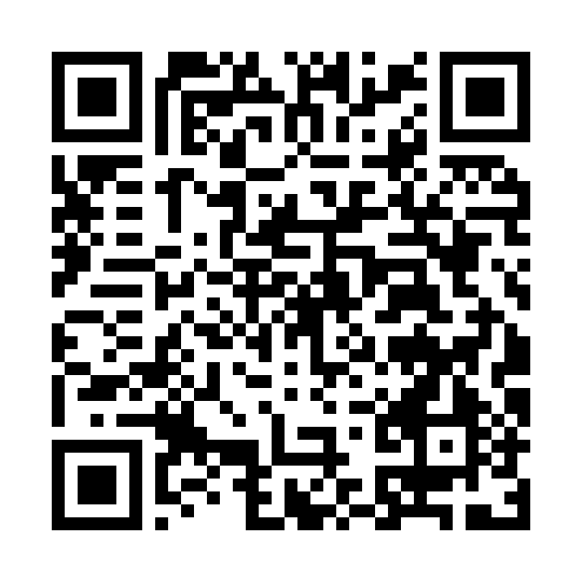
LEAD QUALITY
A lead needs a reason to be on the list
EXAMPLE STUDIO
01
Source: where did you find the person
or organisation?
SOURCE
Fictional classroom scenario
02
Evidence: what observable fact
suggests a possible fit?
OBSERVED
Publishes weekly articles
03
Unknown: what must you verify before
UNKNOWN
Need for outside support
reaching out?
NEXT ACTION
Ask about the current process
Get the template
Fictional record. An observation and an inference are different kinds of evidence.
CONNECTEA / COURSE 5 / 0205EE
18

Slide 19

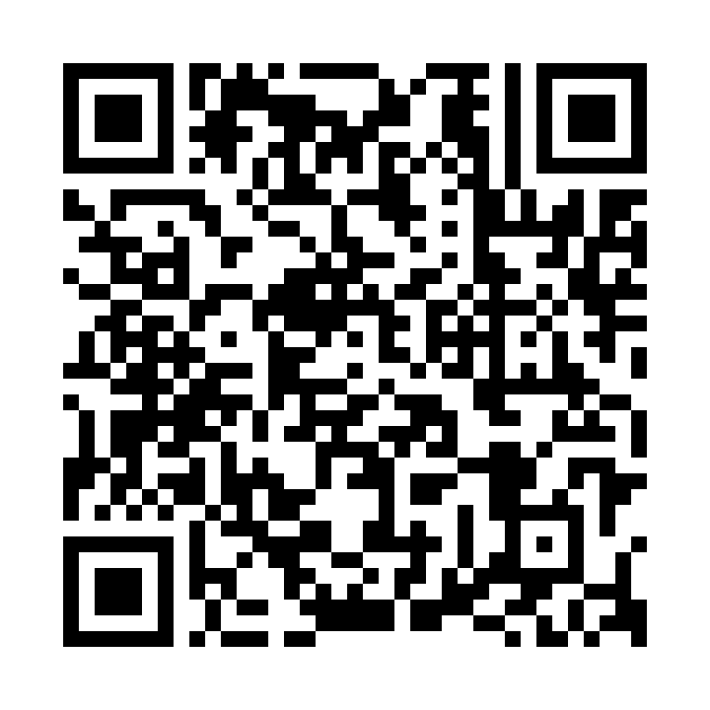
AI RESEARCH
Ask for evidence, not invented contacts
01
Use only these sources. Quote the fact
supporting fit.
02
Return source, observation,
uncertainty, and next question.
03
Mark unknowns. Never guess an email or
buying intent.
All classroom links
Course 5 / resources
SCAN OR CLICK TO OPEN
Visual reused from Course 4; editorial illustrations depict fictional scenes.
CONNECTEA / COURSE 5 / 0205EE
19

Slide 20
RESEARCH SPRINT / 15 MIN
Build five useful starting records
01
02
03
Find five candidates, or
For each, record evidence
Peer-check the sources
a relevant opt-in
of fit and what is
and reject weak matches.
recruitment route.
unknown.
CRM template
Course 5 / CRM template
SCAN OR CLICK TO OPEN
CONNECTEA / COURSE 5 / 0205EE
20

Slide 21
BREAK / 10 MIN
Bring back one candidate worth discussing
01
What makes this person or organisation
relevant?
02
What evidence do you have?
03
What is the smallest sensible next
step?
All classroom links
Course 5 / resources
SCAN OR CLICK TO OPEN
Visual reused from Course 4; editorial illustrations depict fictional scenes.
CONNECTEA / COURSE 5 / 0205EE
21

Slide 22
CRM BASICS
A CRM remembers the relationship
IDENTIFIED
REVIEWED
REPLIED
Example Studio
Example Shop
Example Academy
Verify the need
Draft an invitation
Agree a test date
Every active record: an owner + a dated next action.
Teaching diagram with fictional organisations; not an Attio screenshot.
CONNECTEA / COURSE 5 / 0205EE
22

Slide 23
TOOL MAP
Choose tools by the job they do
FIND
DistroNow + Treg
Candidates and source evidence
ORGANISE
Attio / HubSpot / folk / Twenty
Contacts and next actions
CHECK
LEGIT AGENTIC + Ora
Website readiness
All classroom links
Course 5 / resources
SCAN OR CLICK TO OPEN
Choose one CRM for the workshop; other tools support different parts of the journey.
CONNECTEA / COURSE 5 / 0205EE
23

Slide 24
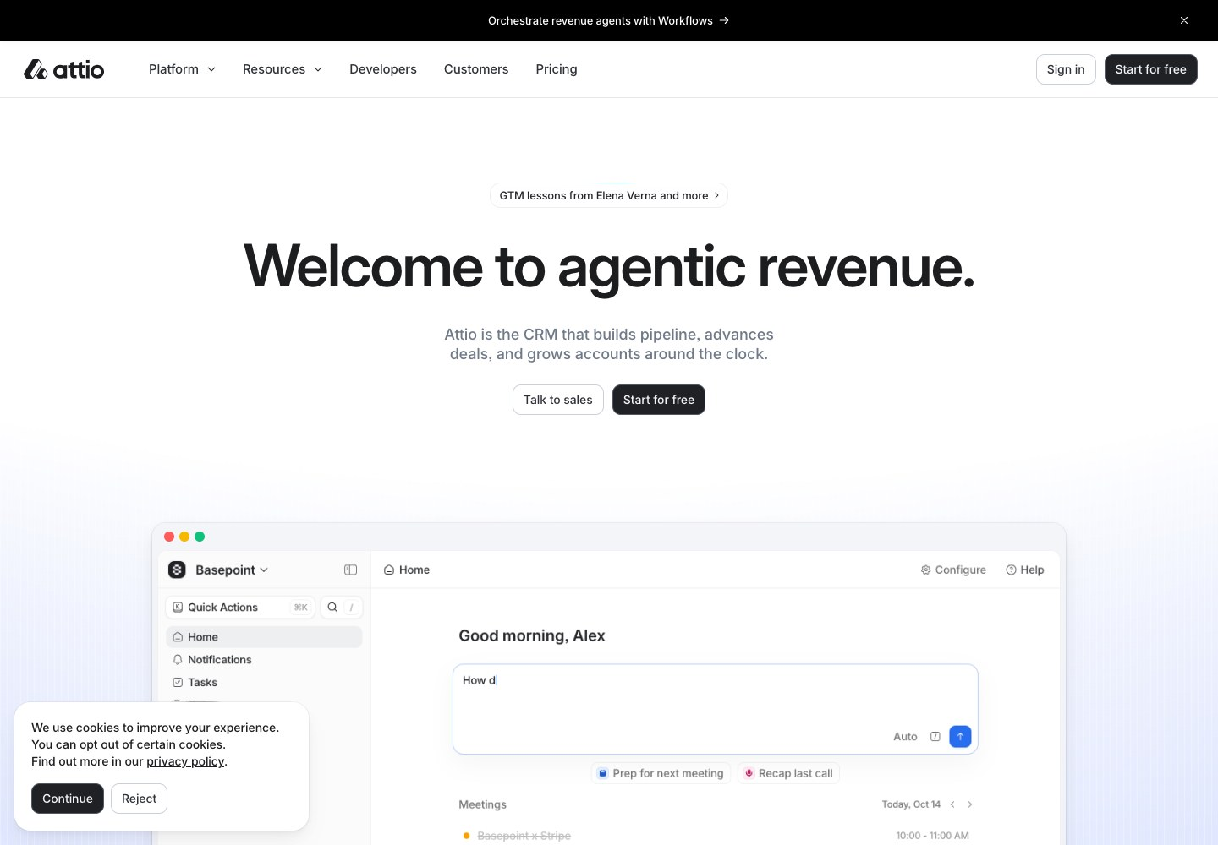
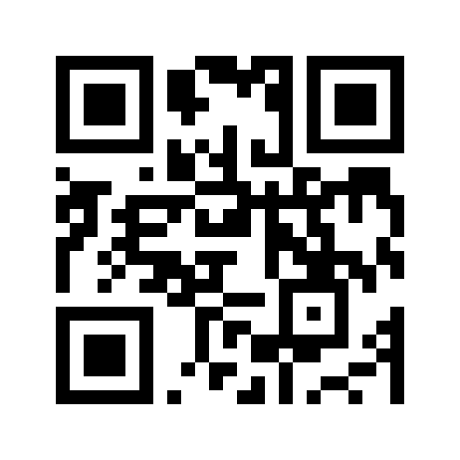
CRM / CLASS DEFAULT
Attio: start with a small shared pipeline
01
Free plan: up to 3 seats and 50,000
records.
02
Create one list with stage, owner
and next action.
03
Keep advanced AI and automation
optional.
Attio
attio.com
Attio official public website, captured 5 Oct 2026. QR opens the named resource.
CONNECTEA / COURSE 5 / 0205EE
24
Attio pricing

Slide 25
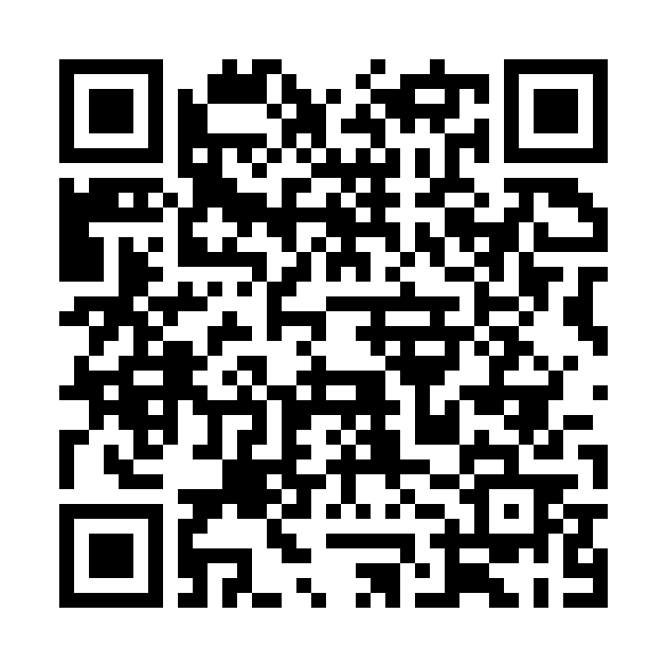
ATTIO / 12-MINUTE LAB
Import, review, and move one record
01
Prepare five company records with
unique domains.
02
Map CSV columns, preview, then check
the saved data.
03
Update one stage and next action;
export your evidence.
Attio Academy
attio.com / Help /
Academy
Attio official public website, captured 5 Oct 2026. QR opens the named resource.
CONNECTEA / COURSE 5 / 0205EE
25
Attio CSV import guide

Slide 26
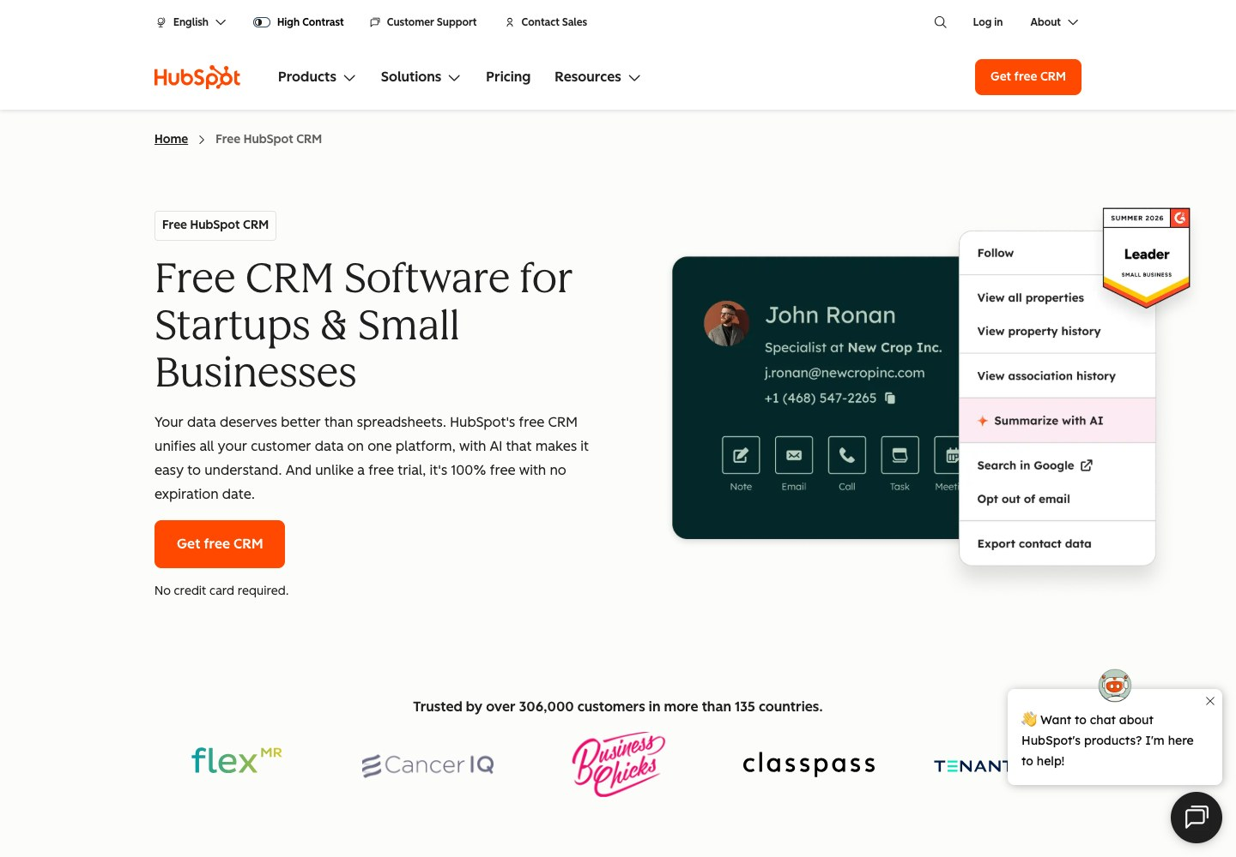
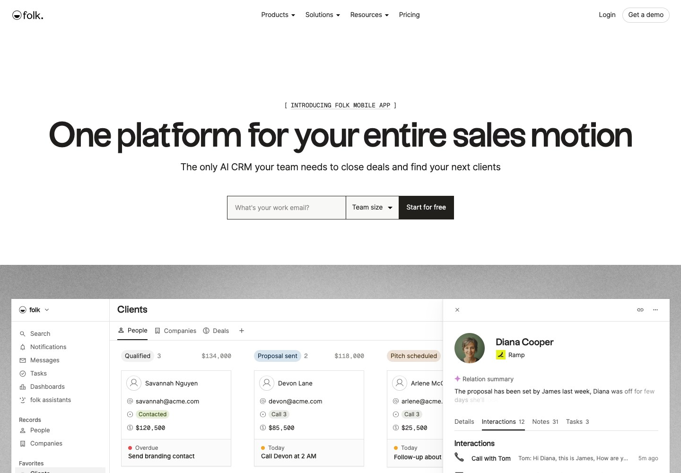
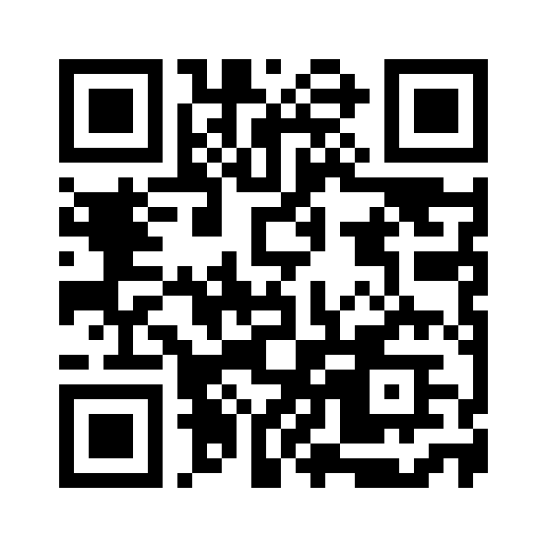
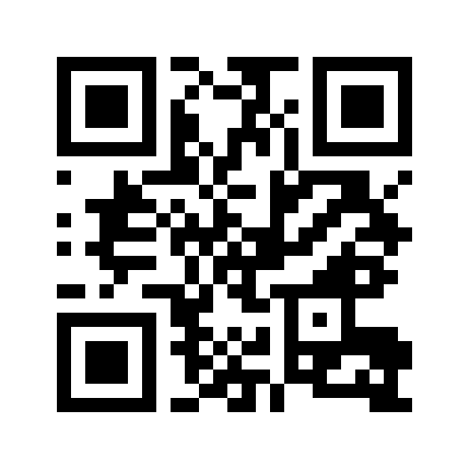
CRM / ALTERNATIVES
HubSpot or folk: choose for your workflow
HubSpot CRM
folk
Free CRM: 2 users / 1,000 contacts
Relationship CRM / 14-day trial
hubspot.com/products/crm
folk.app
Official public product pages. Plans checked 5 Oct 2026; recheck before choosing.
CONNECTEA / COURSE 5 / 0205EE
26
HubSpot CRM
folk pricing

Slide 27
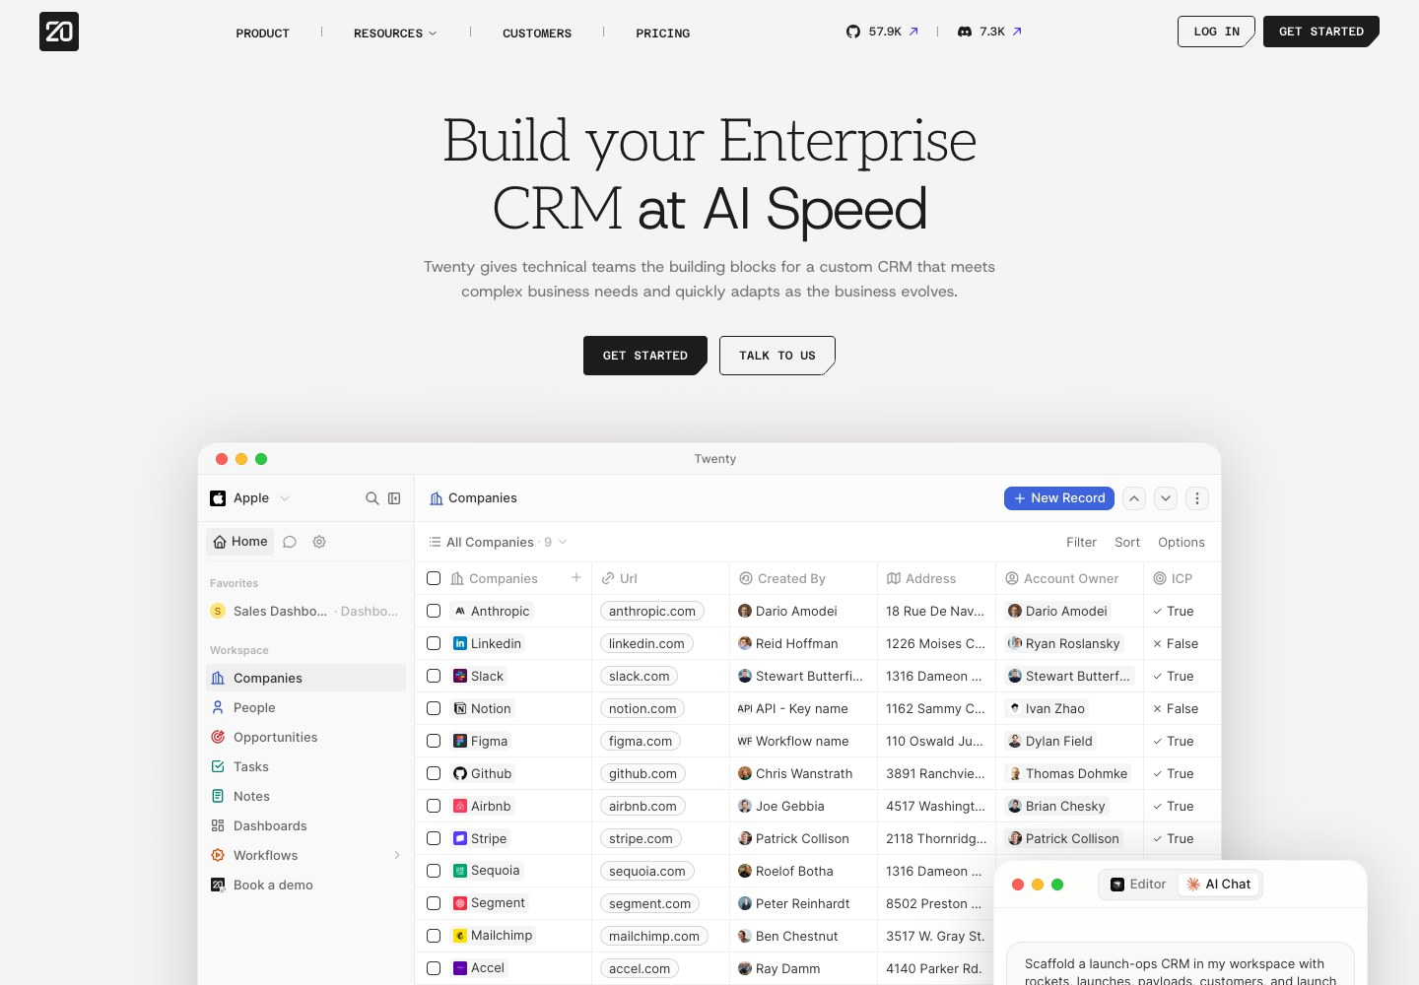
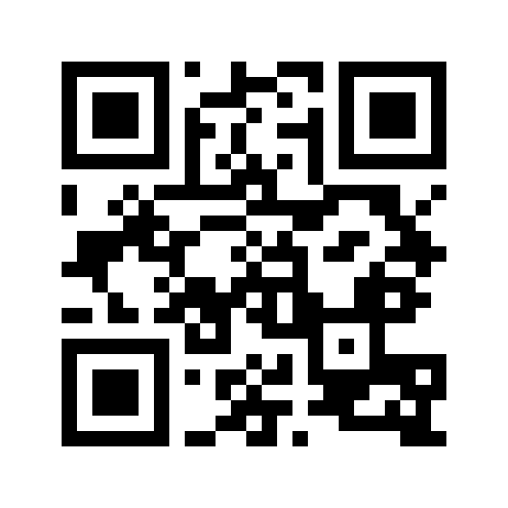
CRM / BUILDER EXTENSION
Twenty: explore a customisable CRM
01
Open-source CRM with cloud and self-
hosting options.
02
Cloud: 30-day trial; Pro
$9/user/month billed yearly.
03
Use an existing workspace for the
optional demo.
Twenty
twenty.com
Twenty official public website, captured 5 Oct 2026. QR opens the named resource.
CONNECTEA / COURSE 5 / 0205EE
27
Twenty pricing

Slide 28
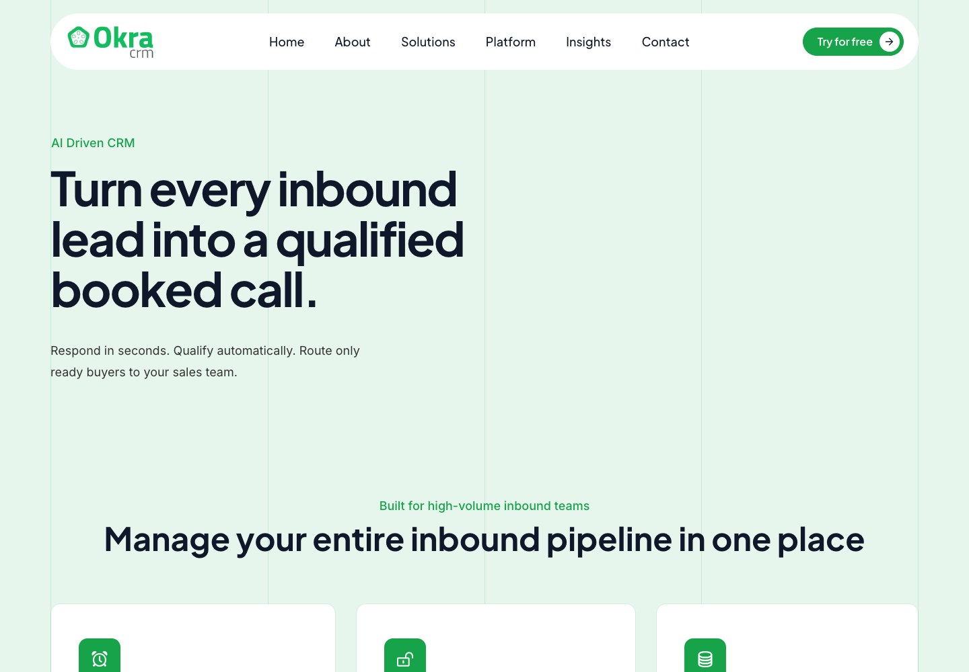
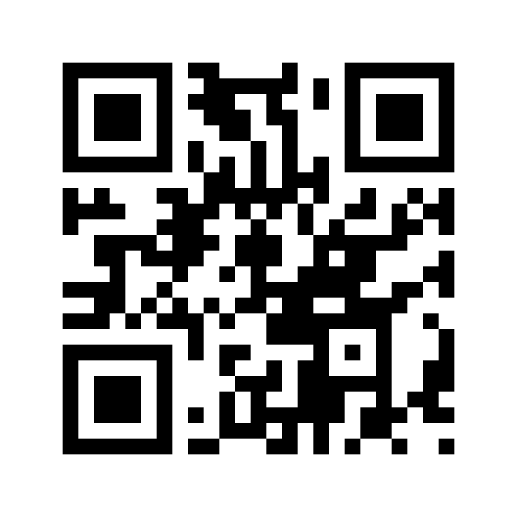
OKRA / EVALUATE FIRST
Okra CRM focuses on inbound enquiries
01
Vendor describes AI response,
qualification and booking.
02
Classroom access and pricing still
need confirmation.
03
Use it as a workflow discussion
until verified.
Okra CRM
okracrm.com
Okra official public website, captured 5 Oct 2026. QR opens the named resource.
CONNECTEA / COURSE 5 / 0205EE
28
Okra CRM vendor site

Slide 29
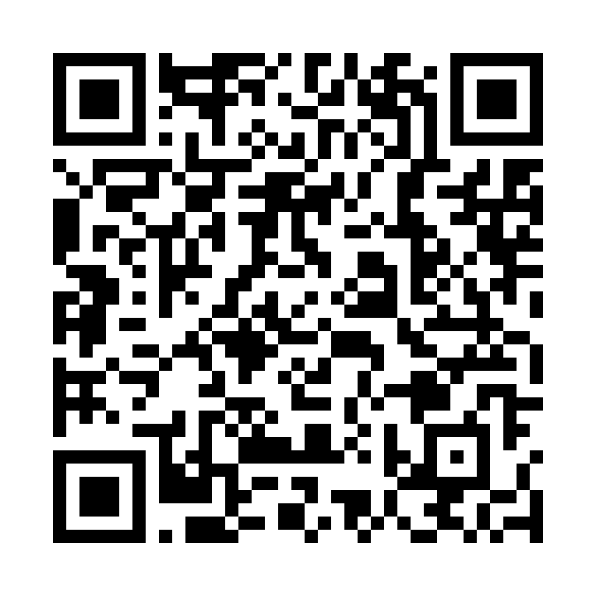
YOUR STACK / DISTRONOW
Demonstrate the complete lead journey
REVIEW
VERIFY
DRAFT
RECORD
Buyer fit
Demo result
Human check
Reply + meeting
Use the fictional /leads-finder
workspace. Simulated results are
DistroNow demo guide
practice evidence only.
Course 5 / tools / DistroNow demo
SCAN OR CLICK TO OPEN
DistroNow repository demo. Live data-provider compatibility still requires checking.
CONNECTEA / COURSE 5 / 0205EE
29
DistroNow setup
Current Treg docs

Slide 30

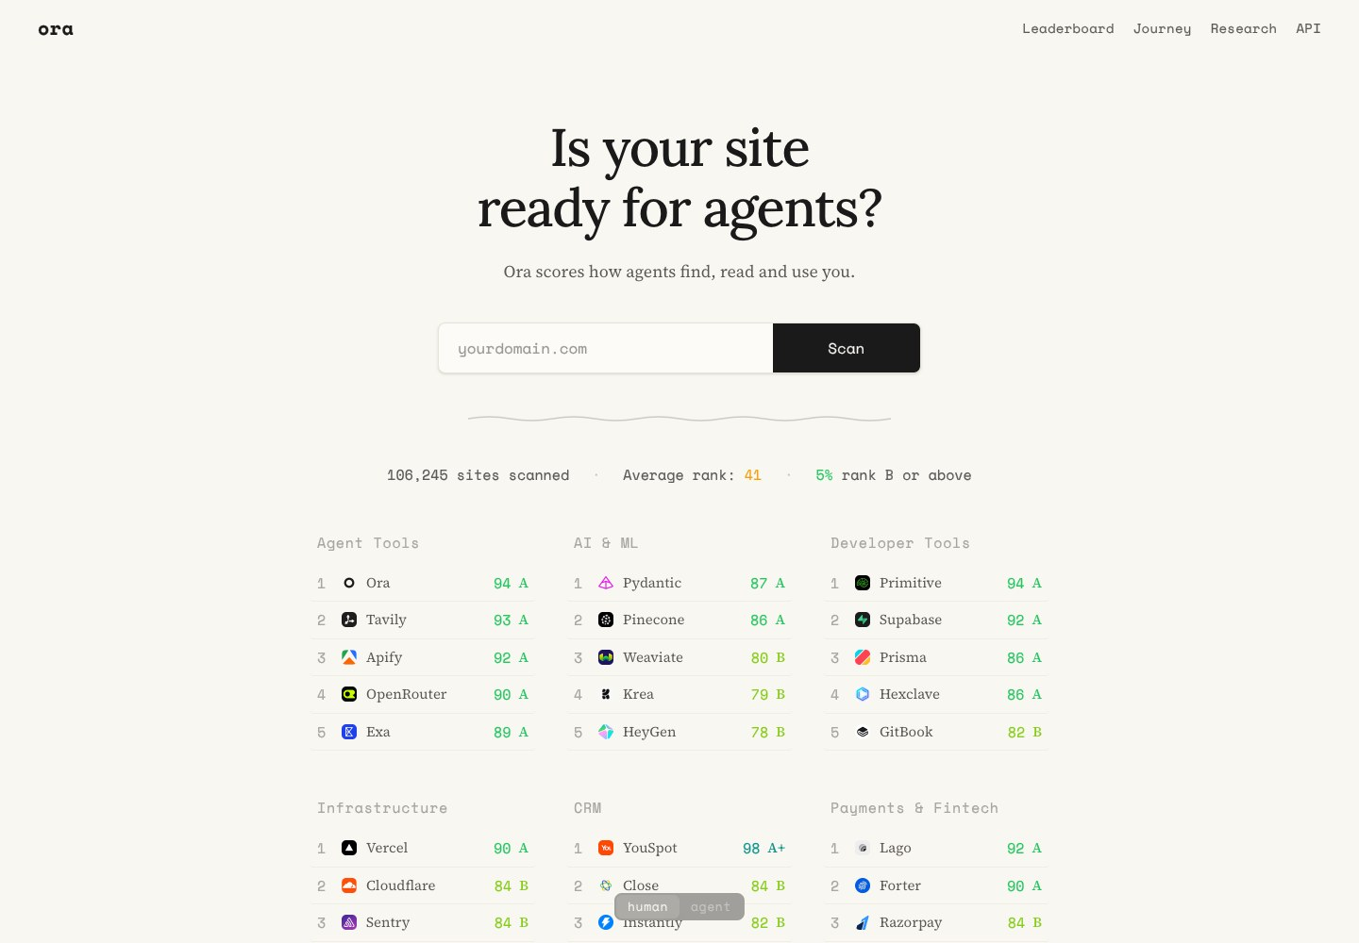
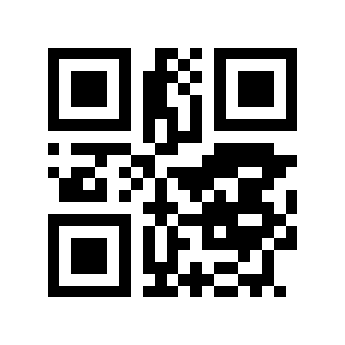
YOUR STACK / WEBSITE CHECK
Use LEGIT AGENTIC or Ora to find friction
LEGIT AGENTIC
Ora
legit-agentic.vercel.app
ora.ai
Website-readiness checks do not prove customer demand or AI recommendations.
CONNECTEA / COURSE 5 / 0205EE
30
LEGIT AGENTIC
Ora / Vercel announcement

Slide 31
PIPELINE
Move a record when something actually happens
IDENTIFIED
REVIEWED
REPLIED
Example Studio
Example Shop
Example Academy
Verify the need
Draft an invitation
Agree a test date
Every active record: an owner + a dated next action.
Teaching diagram with fictional organisations; not an Attio screenshot.
CONNECTEA / COURSE 5 / 0205EE
31

Slide 32
MINIMUM RECORD
Every active lead needs a next action
EXAMPLE STUDIO
01
Identity, source, evidence of fit,
and unknowns.
SOURCE
Fictional classroom scenario
02
Stage, owner, last interaction, next
action, due date.
OBSERVED
Publishes weekly articles
03
Outcome and contact preference,
UNKNOWN
Need for outside support
including do not contact.
NEXT ACTION
Ask about the current process
Get the template
Fictional record. An observation and an inference are different kinds of evidence.
CONNECTEA / COURSE 5 / 0205EE
32

Slide 33
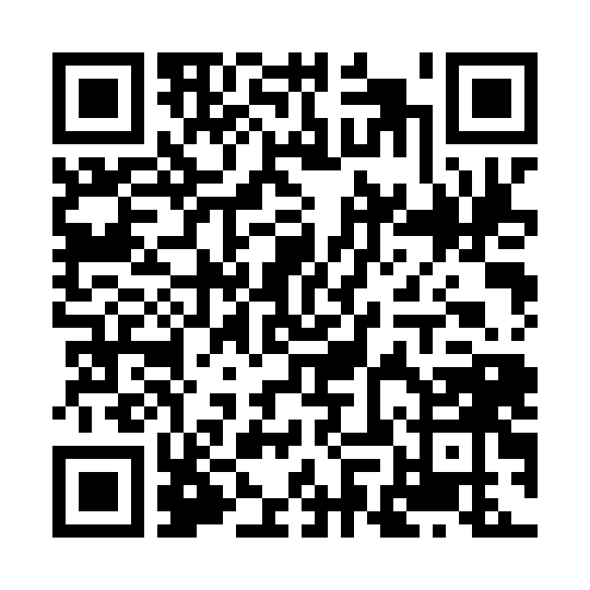
CRM SPRINT / 12 MIN
Make the list usable by someone else
01
Import or copy your researched records.
02
Assign each active record an owner and
next action.
03
Hand it to a teammate: can they explain
what to do next?
Attio classroom lab
Course 5 / tools / Attio lab
SCAN OR CLICK TO OPEN
Visual reused from Course 4; editorial illustrations depict fictional scenes.
CONNECTEA / COURSE 5 / 0205EE
33

Slide 34
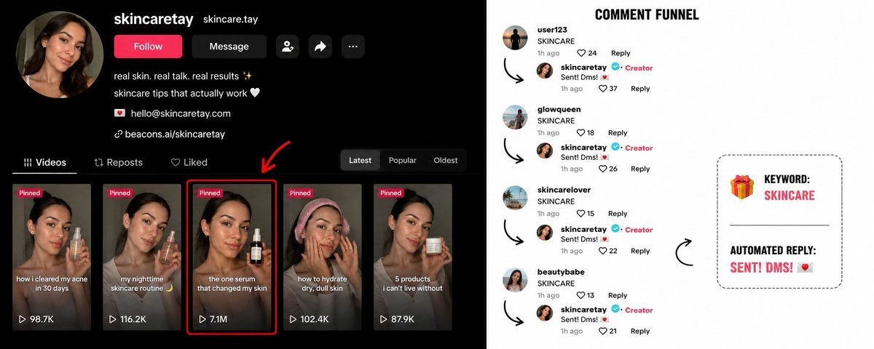
FIRST MESSAGE
Give someone a reason to answer
01
Relevant observation: something you
actually verified.
02
Useful offer: a clear outcome, without
invented claims.
03
Small ask: one question or a short
conversation.
DISCUSS > TRY > CHECK > REFLECT
Visual reused from Course 4; editorial illustrations depict fictional scenes.
CONNECTEA / COURSE 5 / 0205EE
34

Slide 35
DISCOVERY
Learn about what already happens
01
When did you last experience this
problem?
02
How did you handle it, and what was
difficult?
03
What would make trying a different
approach worthwhile?
DISCUSS > TRY > CHECK > REFLECT
Visual reused from Course 4; editorial illustrations depict fictional scenes.
CONNECTEA / COURSE 5 / 0205EE
35

Slide 36

FOLLOW-UP
Respect the answer, including no
01
Log the response and agree the next
step if there is one.
02
For this exercise, make at most one
unanswered follow-up.
03
Stop on refusal and mark the record
accordingly.
DISCUSS > TRY > CHECK > REFLECT
Visual reused from Course 4; editorial illustrations depict fictional scenes.
CONNECTEA / COURSE 5 / 0205EE
36

Slide 37
MESSAGE CLINIC / 8 MIN
Write three drafts and review one closely
01
Personalise with relevant verified
facts.
02
Remove vague promises, false
familiarity, and pressure.
03
Ask a teammate: would you understand
why this was sent?
Assignment workbook
Course 5 / assignment workbook
SCAN OR CLICK TO OPEN
Visual reused from Course 4; editorial illustrations depict fictional scenes.
CONNECTEA / COURSE 5 / 0205EE
37

Slide 38

CAPTURE FLOW
Connect the advertisement to the next step
01
Ad or website > clear action > short
enquiry form.
02
Form > saved record > responsible
owner.
03
Owner > dated follow-up task > visible
outcome.
DISCUSS > TRY > CHECK > REFLECT
Visual reused from Course 4; editorial illustrations depict fictional scenes.
CONNECTEA / COURSE 5 / 0205EE
38

Slide 39
CAPTURE TEST / 10 MIN
Check the handoff, not just the button
01
Submit dummy data and locate the saved
result.
02
Try missing fields, a duplicate, and a
failed handoff.
03
Confirm who follows up and what the
visitor is told.
Assignment workbook
Course 5 / assignment workbook
SCAN OR CLICK TO OPEN
Visual reused from Course 4; editorial illustrations depict fictional scenes.
CONNECTEA / COURSE 5 / 0205EE
39

Slide 40
MEASUREMENT
Count each step separately
5
INVITATIONS
2
REPLIES
1
BOOKED TEST
Reply rate = 2 / 5. A booking is not a completed test.
Fictional numbers for learning. Record actual outcomes and the observation period.
CONNECTEA / COURSE 5 / 0205EE
40

Slide 41
SEVEN-DAY EXPERIMENT
Decide what the evidence would change
01
We believe [segment] experiences
[problem].
02
We will test [offer] through
[appropriate channel].
03
If [signal], we will [decision];
otherwise investigate [why].
DISCUSS > TRY > CHECK > REFLECT
Visual reused from Course 4; editorial illustrations depict fictional scenes.
CONNECTEA / COURSE 5 / 0205EE
41

Slide 42
BACK TO THE ASSIGNMENT
Where does this work go?
CUSTOMER RESEARCH
>
Opportunity + concept
CONVERSATIONS + TESTS
>
Testing evidence
DECISIONS + CHANGES
>
Iterations + reflection
Your tools serve the eight existing portfolio items.
No ninth submission item and no new sales quota.
CONNECTEA / COURSE 5 / 0205EE
42

Slide 43
WORKED EXAMPLE / FICTIONAL
A complete evidence chain
OBSERVATION
CHANGE
RETEST
Two testers missed the
Move it beside the
Check whether new
enquiry action.
product details.
users finish the task.
Make the evidence > decision > check visible.
Fictional example. A planned retest must not be presented as completed.
CONNECTEA / COURSE 5 / 0205EE
43

Slide 44
INDIVIDUAL REFLECTION
Say what you did and what you learned
01
I contributed [specific work] and
checked [evidence].
02
I expected [assumption], but observed
[actual result].
03
I changed [decision]; next I will test
[remaining risk].
Assignment workbook
Course 5 / assignment workbook
SCAN OR CLICK TO OPEN
Visual reused from Course 4; editorial illustrations depict fictional scenes.
CONNECTEA / COURSE 5 / 0205EE
44

Slide 45
ASSESSMENT DISCUSSION
What makes a portfolio stronger?
01
02
03
Functional prototype and
Clear reasoning and
Robust validation and
basic evidence establish
evidence-led changes
mature reflection support
the base.
strengthen it.
excellence.
Apply this to your own project.
CONNECTEA / COURSE 5 / 0205EE
45

Slide 46
PEER REVIEW / 8 MIN
Can another person follow your evidence?
01
Open the live site, repository, and
advertisement links.
02
Trace one observation to a change and
its check.
03
Identify one missing item and one
unclear claim.
Assignment workbook
Course 5 / assignment workbook
SCAN OR CLICK TO OPEN
Visual reused from Course 4; editorial illustrations depict fictional scenes.
CONNECTEA / COURSE 5 / 0205EE
46

Slide 47
ASSIGNMENT QUESTIONS
Resolve these before you submit
01
02
03
No sales yet? Show honest
Worked as a team? Explain
No reply? Record it;
testing, learning, and
your individual
investigate fit, channel,
iteration.
contribution.
and offer.
Assignment workbook
Course 5 / assignment workbook
SCAN OR CLICK TO OPEN
CONNECTEA / COURSE 5 / 0205EE
47

Slide 48
LEAVE WITH A NEXT STEP
One customer. One question. One action.
01
A credible customer hypothesis and a
usable CRM.
02
A tested capture flow and a seven-day
experiment.
03
An honest portfolio with a clear next
improvement.
All classroom links
Course 5 / resources
SCAN OR CLICK TO OPEN
Visual reused from Course 4; editorial illustrations depict fictional scenes.
CONNECTEA / COURSE 5 / 0205EE
48

